Slide 1
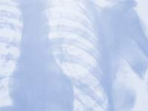
HS1 – Sect. 2
Skeletal System
How many bones do you have???
206

Slide 2
5 Functions of the Skeletal System:
Support
Protection
Movement
Storage (minerals)
Hemopoiesis
(WBC’s made in yellow marrow)
(RBC’s made in red marrow)

Slide 3
Bone Formation

Slide 4
Types of bone cells include the following:
Osteoblast -forms new bone tissue
Osteoclast-- formed in bone marrow
-absorbs & removes unwanted tissue
Osteocyte -maintain bone as living tissue
Hemapoietic--found in bone marrow
-produces RBC’s (erythrocytes)

Slide 5
How are bones formed?
Embryo skeleton starts as osteoblasts, then changes to cartilage
Ossification (bone replaces cartilage) starts @ 8 wks (why infant bones are so pliable)
Fontanel – soft spot on baby’s head

Slide 6
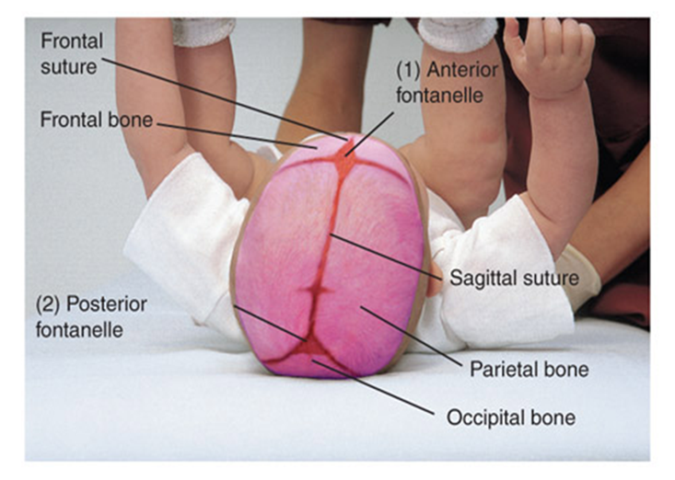
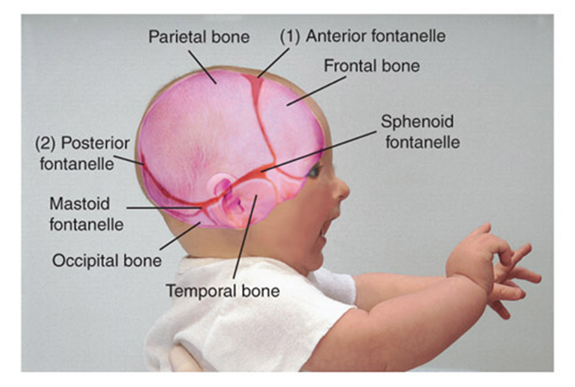
3 Fontanel Locations:
Anterior
Posterior
Sphenoid

Slide 7
Types of Bones

Slide 8
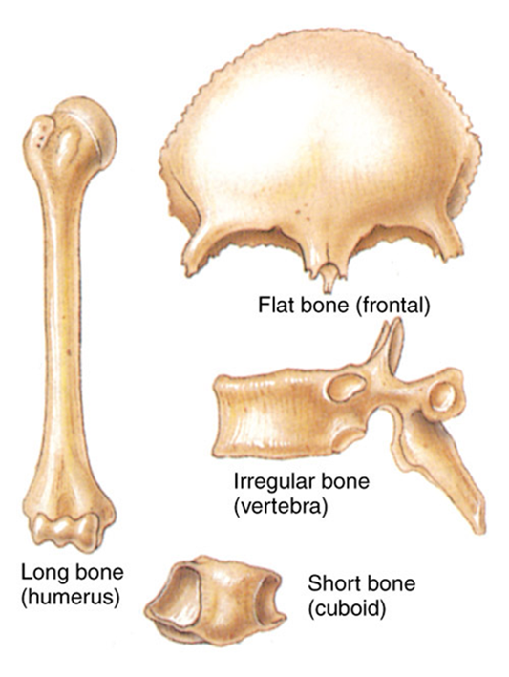
Long Bones –
arms & legs
Flat Bones –
skull & ribs
Irregular Bones – spinal column
Short Bones - wrist
4 Types

Slide 9
-Structures of the Long Bone-
Diaphysis –shaft, hollow. Makes long bone strong, hard, & light.
Epiphysis – Ends
Medullary Canal – Center of shaft. Filled with yellow bone marrow . Fat storage center.
Endosteum – Lining of marrow canal. Keeps cavity intact.

Slide 10
-Structures of the Long Bone Cont…-
Periosteum – Covers outside.
Tough fibrous tissue. Needed for bone growth, repair, & nutrition.
Articular Cartilage – Covers the epiphysis. Thin layer. Shock absorber b/t 2 bones.
Synovial fluid – reduces the friction during joint movement.

Slide 11
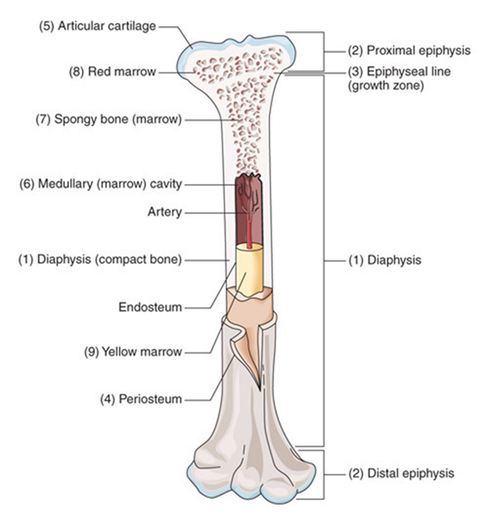
L
O
N
G
B
O
N
E
S
T
R
U
C
T
U
R
E
Structures of the Long Bones

Slide 12
Types of Skeletons

Slide 13
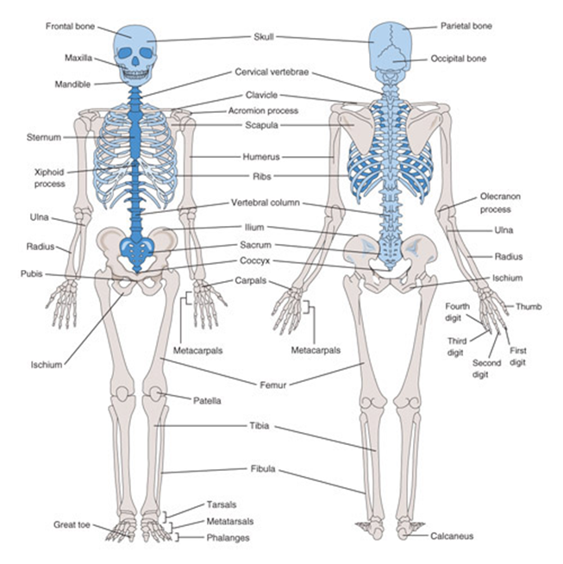
*206 Bones in the Adult Skeleton*
*2 types of Skeletons:
Axial Skeleton – (80)Skull, Spinal Column, Ribs, Sternum, and hyoid
Appendicular Skeleton – (126) Upper extremities and Lower extremities
Axial Skelton = Blue
Appendicular Skelton =Beige

Slide 14
Axial Skeleton

Slide 15
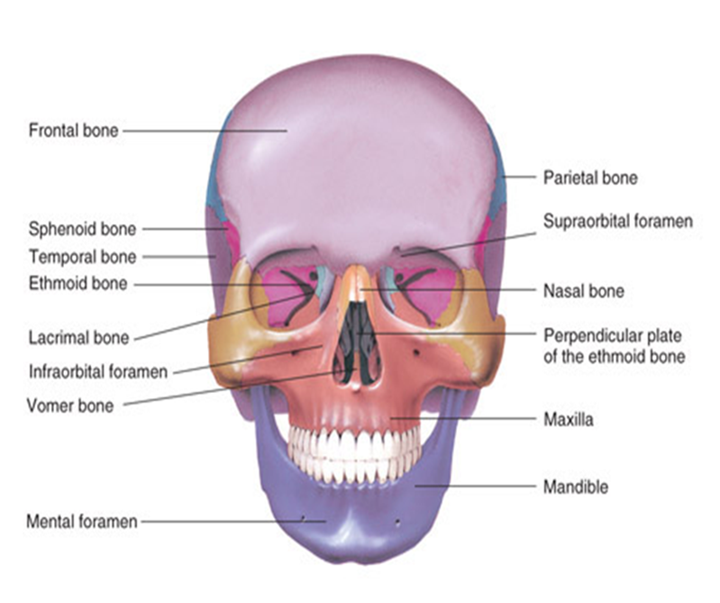
S
K
U
L
L
F
R
O
N
T
A
L
V
I
E
W

Slide 16
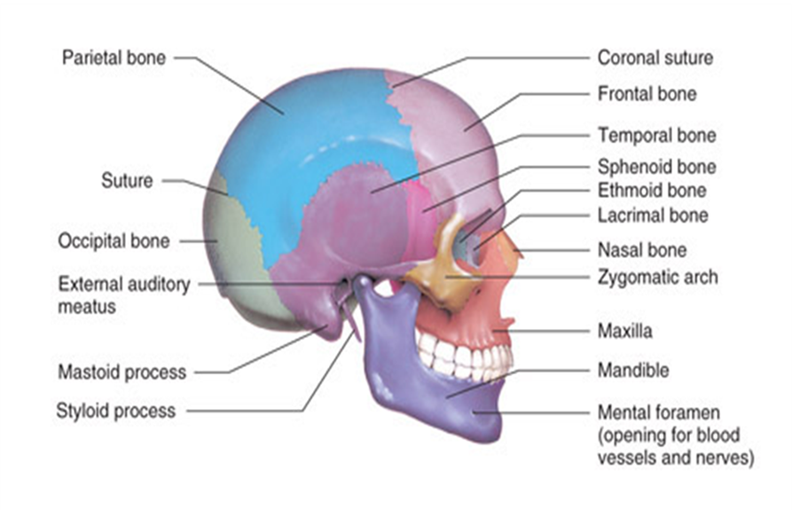
L
A
T
E
R
A
L
S
K
U
L
L
V
I
E
W

Slide 17
Skull = cranium & facial bones
*22 bones (8 cranium, 14 facial)
*Thin & slightly curved.
*Hyoid bone only bone that doesn’t connect to any other bone
*Mandible only moveable facial bone
*Sutures hold cranial bones together
Skull facts

Slide 18
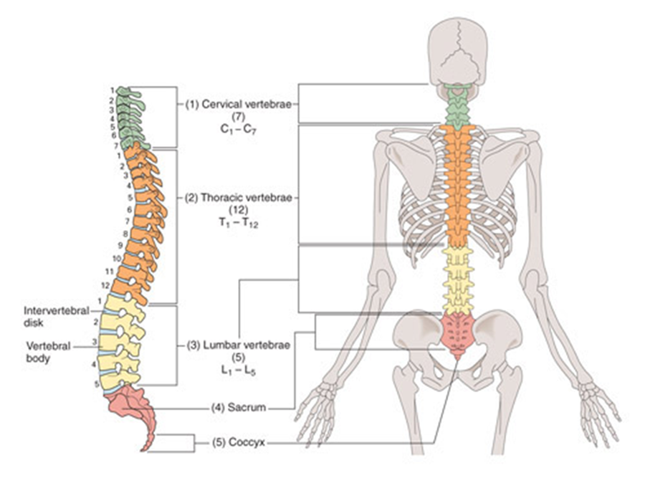
Spinal Column

Slide 19
Spinal Column Facts:
“vertebral column”
Supports the head
Provides for the attachment of the ribs

Slide 20
Ribs & Sternum

Slide 21
Rib & Sternum Facts
Sternum:
3 parts
Upper region (manubrium)
2. Body
3. Lower (Xiphoid process which is cartilage)
Ribs:
12 Pairs total
7 pairs true ribs
connected to the sternum by costal cartilage
3 pairs false ribs
connected to 7th true rib instead of sternum
2 pairs floating ribs
Not connected to sternum or other ribs

Slide 22
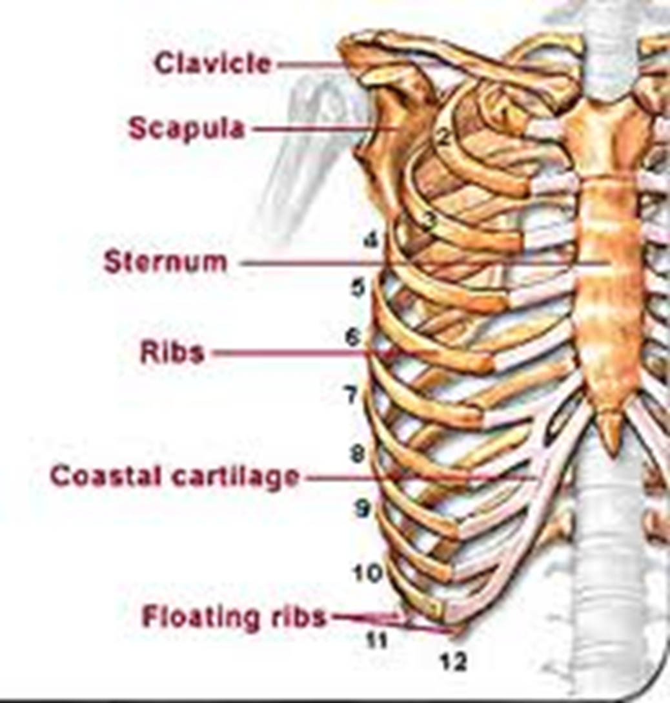

Slide 23
Appendicular Skeleton

Slide 24
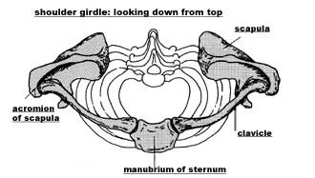
Shoulder Girdle
4 bones
2 Clavicles (collar bones)
2 Scapulae (shoulder bones)
Clavicle –braces the shoulders & prevents excessive forward motion
-attached @ one end of the scapulae and the sternum
Scapulae –attaches muscles that assist in arm movement and serve as a place of attachment for the arms.

Slide 25
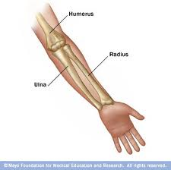
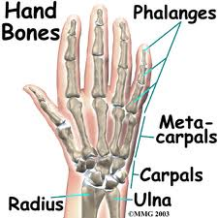
Arms & Hands
Arms - 3 Bones
Humerus
Radius
Ulna
Hands – 27 Bones
Carpals (8 x 2)
Metacarpals (5 x2)
Phalanges (14x2)
Distal Phalange
Medial Phalange
Proximal Phalange

Slide 26
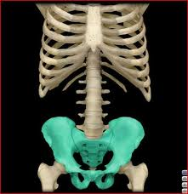
Pelvic Girdle
Ilium, Ischium, & Pubis
*Female pelvis is wider than males for childbirth. Also the pelvic inlet is wider in the female and the pelvic bones are lighter and smoother than those of the male. (label on full skeleton diagram)
Ischium
Ilium
Pubis

Slide 27
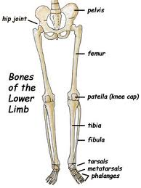
Leg & Foot
Leg
Femur – Longest/strongest bone “Thigh bone”
Patella – “Kneecap”
Cartilage as a baby, then hardens to
bone @ 5-6years
Surrounded by 4 bursae to cushion
Tibia - largest lower leg bone
Fibula – smallest leg bone
Ankle
Tarsals - 7 bones,
Foot
Metatarsal – 5 bones – foot
Phalanges – 14 bones – toes
Calcaneus – Heel

Slide 28
Joints
“articulations”
Points of contact b/t 2 bones.
3 main types by degree of movement:
1. Diarthroses (moveable)
-Most of the body’s joints
-4 types
Ball-and-socket –greatest movement. Shoulders & Hips
Hinge – move in one direction. Knees, elbows, & outer joints of fingers
Pivot – extension rotating in a second, arch-shaped bone. Radius & Ulna.
Gliding – flat surfaces glide across each other. Vertebrae.
2. Amphiarthroses (partially moveable)
-ribs attached to spine
3. Synarthroses (immovable)
-cranium

Slide 29
