Slide 1
Respiratory Disorders

Slide 2
What we will cover….
Asthma
Bronchitis
COPD
Common Cold
Emphysema
Influenza
Pneumonia
Pneumothorax
Sinusitis
Tuberculosis

Slide 3
Asthma

Slide 4
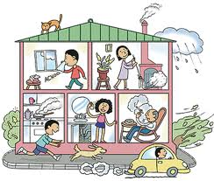
Asthma
Airway obstructed r/t inflammatory response to a stimuli. (allergy, psych, stress, smoking, obesity, etc…
Sx: Dyspnea, Wheezing, Difficulty Inhaling, tightness in the chest.
Tx: Inhaled steroids (prevention), Alb. Inhaler (rescue), lifestyle changes, get rid of the allergy source.

Slide 5
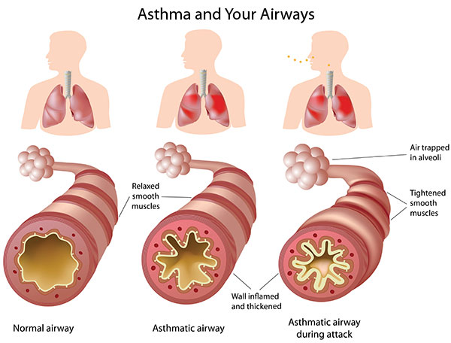
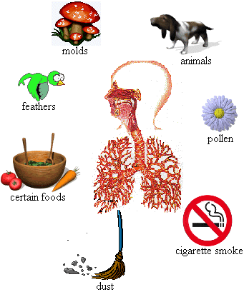

Slide 6
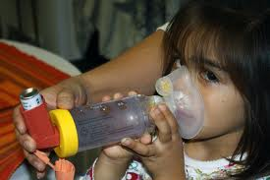
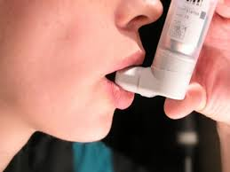
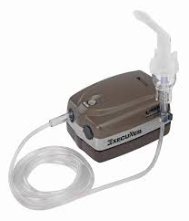

Slide 7
Bronchitis

Slide 8
Bronchitis
Inflammation of mucous membrane of the trachea & bronchial tubes
2 types: Acute & Chronic
Acute: Sx -cough, fever, & rales (raspy sound) Tx: antibiotics, inhalers prn
Chronic: #1 cause smoking, Sx include
severe/persistant cough & large amt’s of discolored sputum. Tx: Stop smoking, inhalers

Slide 9
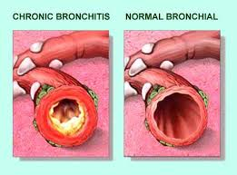
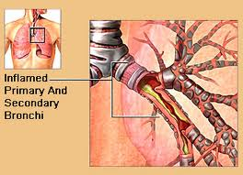
s

Slide 10
COPD

Slide 11
COPD
Chronic Obstructive Pulmonary Disease
Term used to describe chronic lung conditions
Most common conditions are Emphysema & Chronic Bronchitis

Slide 12
Common Cold

Slide 13
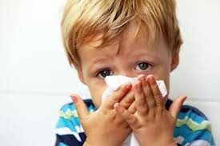
Common Cold
Highly contagious virus
Lowers body's resistance to making it susceptible to infections
Sx: Rhinorrhea, Fatigue, fever, chills
Tx: Rest, Warm Fluids

Slide 14
Emphysema

Slide 15
Emphysema
Alveoli over dilate, lose elasticity & cannot rebound
-alveoli may rupture
-Air becomes trapped making it difficult to exhale causing decrease CO2 & O2
Sx: Dyspnea, becomes more severe with progression of disease
Tx: Alleviate Sx, less exposure to irritants, stop smoking

Slide 16
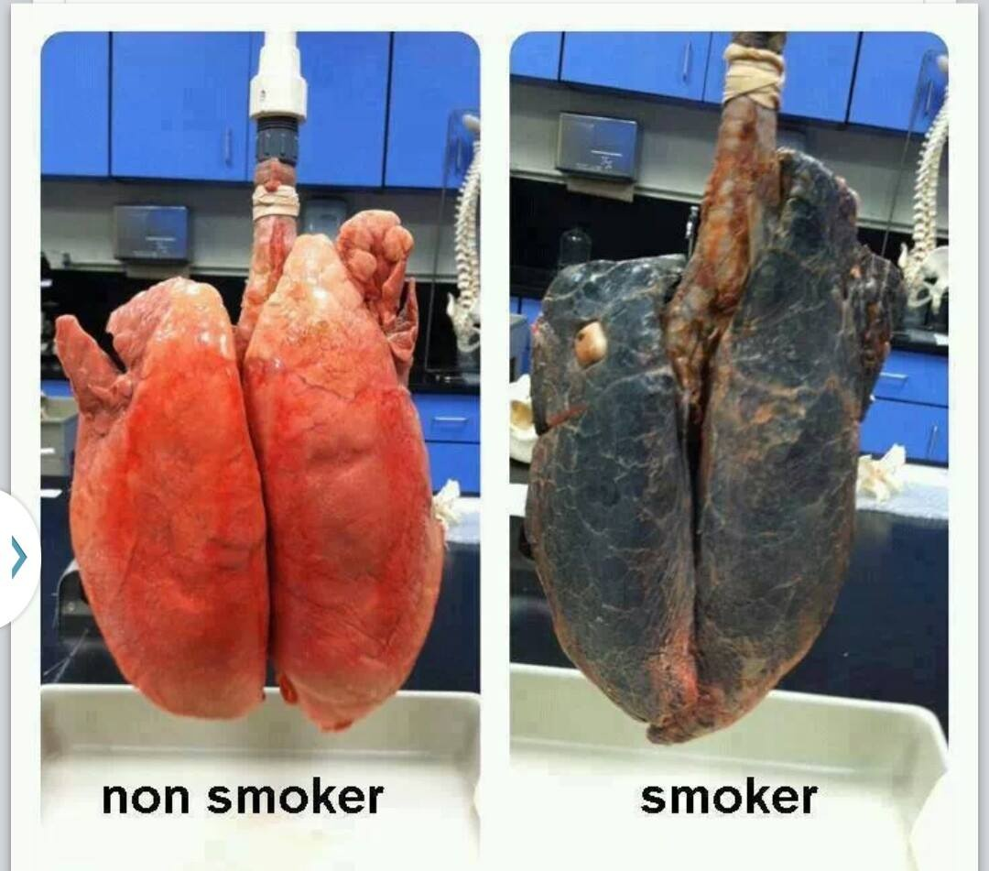
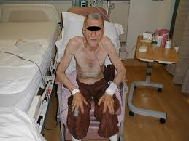

Slide 17
Influenza

Slide 18
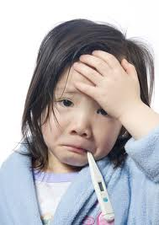
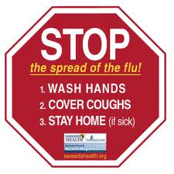
Influenza
“Flu”
Viral infection with inflammation of the mucus membrane
Sx: Fever, rhinorrhea, myalgia, & extreme fatigue
Tx: Sx
Complications: otitis media,
pneumonia

Slide 19
pneumonia

Slide 20
Pneumonia
Infection of the lung
Can be Bacterial or Viral
Alveoli filled with a thick fluid “exudate”, which contains both pus & rbc’s.
Sx: Chest pain, fever, chills, dyspnea
Tx: Depends on severity, Abx, O2, Admission

Slide 21
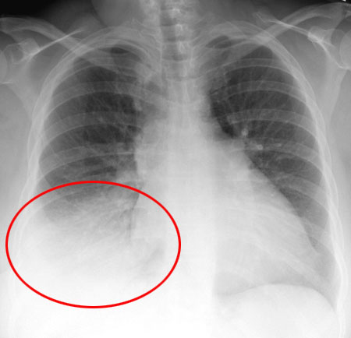

Slide 22
Pneumothorax

Slide 23
Pneumothorax
Buildup of air in pleural cavity on one side of chest.
Excess air, causing pressure on the lung, making it collapse
Breathing not possible but the unaffected lung continues the breathing process
Sx: Dyspnea, Apnea
Tx: Chest Tube to re-inflate the lung

Slide 24
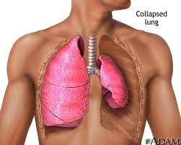
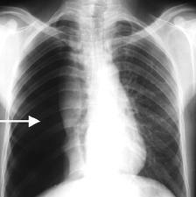
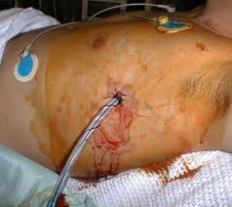
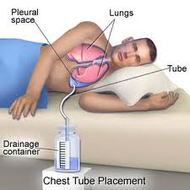

Slide 25
Sinusitis

Slide 26
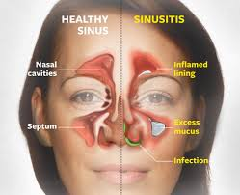
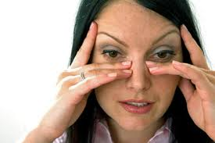
Sinusitis
Infection of the mucus membrane which lines the sinus cavities (1 or more cavities)
Sx: Pain, rhinorrhea, HA
Tx: Antibiotic, cold sx tx

Slide 27
Tuberculosis (TB)

Slide 28
Tuberculosis (TB)
Infectious disease, caused by tubercle bacillus
Can also affect kidneys, bones, & lymphs
“tubercles” (lesions) form in the lung tissue
Sx: Cough, low grade fever, wt loss, night sweats
Test: Mantoux test – skin test which is read within 48-72 hours. If + will have a CXR & sputum sample

Slide 29
Tuberculosis (TB) cont…
Cause for increase in U.S
1. Illigal Immigrants – (don’t go through the screening process)
2. Homeless/poor
3. Aids
New strain of TB resistant to tx’s
Tx: INH x9mos, tx secondary infections

Slide 30
