Slide 1
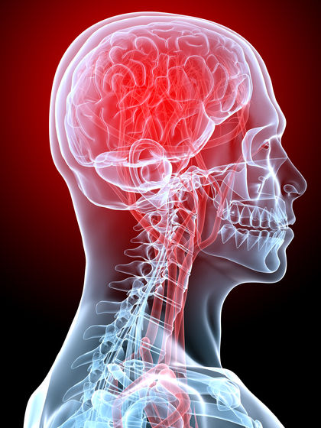
HS1 Section 8
Nervous system

Slide 2
Divided into 3 Parts
CENTRAL NERVOUS SYSTEM – brain and spinal cord
2. PERIPHERAL NERVOUS SYSTEM – cranial
nerves and spinal nerves
3.AUTONOMIC NERVOUS SYSTEM – Peripheral nerves and ganglia

Slide 3
Central nervous system

Slide 4
Central Nervous System
Communication and coordination system of the body
• Intellect and reasoning
Neurons
• Nerve cell
• Transmits a message from one cell to the next
• Has a nucleus, cytoplasm, and cell membrane
Parts of the Neuron…….

Slide 5
Central Nervous System
Parts of the Neuron…..
DENDRITES
• Nerve cell processes that carry impulse to cell
body
• May be one or many
AXON
• Carries impulse away from cell body
• Only one on a neuron
MYELIN SHEATH
• Covering that speeds up the nerve impulse along the axon
SYNAPSE
space between neurons, messages go from one cell to the next

Slide 6
Central Nervous System Types of Neurons…
3 Types:
Sensory
Emerge from the skin or sense organs and carry messages or impulses toward the spinal cord and brain
2. Motor
Carry messages from the brain and spinal cord to the muscles and glands
3. Associative
Carry impulses from the sensory neurons to the motor neurons

Slide 7
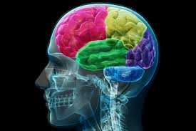
Central Nervous System Brain
• 3 lb mass of soft nervous tissue
• 100 billion neurons
• Protected by skull, three membranes called
meninges, and cerebrospinal fluid
• Adequate blood supply is needed, brain tissue
will die in 4-8 min without
O2

Slide 8
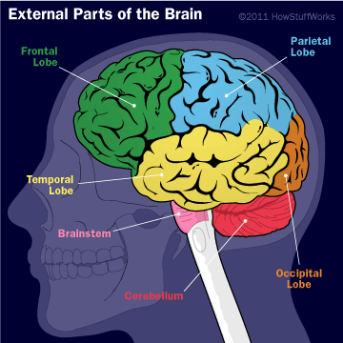
Central Nervous System Brain
Divided into 4 parts:
Cerebrum
(main part – 4 lobes: Frontal, Parietal, Occipital, Temporal)
Diencephalon
(b/t the midbrain and cerebrum)
(contains thalmus & hypothalmus)
3 Cerebellum
4 Brain Stem
(3 parts: Midbrain, Pons,
Medulla oblongata)

Slide 9
Central Nervous System Brain
Coverings of the Brain (MENINGES)
• DURA MATER – outer brain covering, lines the
inside of the skull, tough dense fibrous connective tissue.
• SUBDURAL SPACE – between dura and arachnoid
• ARACHNOID – middle layer, resembles fine cobweb
• PIA MATER – covers the brain’s surface, comprised of blood vessels held together by connective tissue
SUBARACHNOID SPACE - between arachnoid and
pia mater,filled with CEREBROSPINAL FLUID (CSF) –
acts as a liquid shock absorber and source of
nutrients for the brain.

Slide 10
Central Nervous System Brain
Ventricles of the Brain
Brain contains four cavities filled with cerebrospinal fluid called CEREBRAL VENTRICLES.
• Right and left lateral ventricles
• Third ventricle – behind and below the lateral
ventricles
• Fourth ventricle is below the 3rd, in front of the cerebellum and behind the pons and medulla oblongata

Slide 11
Central Nervous System Functions of the Brain Cerebrum
Cerebral cortex: Conscious thought, judgment, memory, reasoning, and will power.
Frontal Lobe: Motor functions, voluntary muscles, speech, Right side = left side of body, Left side = right side of body.
Parietal Lobe: Pain, touch, heat, cold, as well as determines distances, sizes, & shapes.
Occipital Lobe: Controls Eyesight
Temporal Lobe: Hearing & Smell

Slide 12
Central Nervous System Functions of the Brain Cerebellum
Controls all body functions that have to do with skeletal muscles
-Maintenance of balance
-Maintenance of muscle tone
-Coordination of muscle movements

Slide 13
Central Nervous System Functions of the Brain Brain Stem
Provides pathway for messages going to the cerebrum and messages coming back from the cerebrum.
Midbrain: Contains the nuclei for reflex centers involved with vision and hearing
Pons: 2 way conductive pathway for nerve impulses between the cerebrum, cerebellum and other areas of the nervous system.
Medulla: Contains nuclei for vital functions such as heart rate, rate/depth of respiration, blood pressure, swallowing/vomiting.

Slide 14
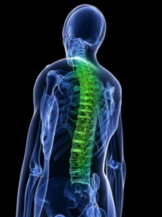
Central Nervous System Spinal Cord
• Begins at foramen magnum of the occipital bone and continues down to 2nd lumbar vertebrae
• White and soft, in spinal canal
• Surrounded by cerebrospinal fluid
• Functions as:
1. Reflex center
2. Conduction pathway to and from the brain

Slide 15
Peripheral Nervous system

Slide 16
Peripheral Nervous System
Includes all the nerves of the body and ganglia (groups of cell bodies)
Connects the central nervous system to the various body structures
Functions:
Controls the involuntary activities of the body
Reflex center of the body

Slide 17
Peripheral Nervous System 2 Types of Nerves
Cranial 12 pairs that begin in the brain
Designated by number and name
Spinal
31 pairs
Originate at the spinal cord and go through openings in the vertebrae

Slide 18
Peripheral Nervous System Cranial Nerves
Number | Name | Function
I | Olfactory | Smell
II | Optic | Vision
III | Oculomotor | Movement of eye muscle
IV | Trochlear | Movement of eye muscle
V | Trigeminal | Face & Teeth Muscles, chewing
VI | Abducens | Movement of eye muscle
VII | Facial | Facial expressions, taste
VIII | Vestibulocochlear | Hearing & balance
IX | Glossopharyngeal | Movement of the throat muscle, taste
X | Vagus | Movement of throat, affects heart, digestive system
XI | Accessory | Movement of neck muscles
XII | Hypoglossal | Movement of tongue muscles

Slide 19
Peripheral Nervous System Spinal Nerves
Name | Location | Function
Cervical Plexus | C1 – C 4 | Supplies Motor Movement to muscles of neck and shoulders and receives messages from these areas *Contains phrenic nerve which stimulates diaphragm
Brachial Plexus | C5-C8, T1 | Supplies motor movement to shoulder, wrist, and hand and receives messages from these areas *Contains Radial Nerve
Lumbar Plexus | T12, L1-L4 | Supplies motor movement to buttocks, anterior leg, and thighs and receives messages from these areas *Contains Femoral Nerve
Sacral Plexus | L4-L5, S1-S2 | Supplies motor movement to posterior of leg and thighs and receives messages from these areas *Contains Sciatic Nerve (largest nerve in body) which must be avoided when giving an IM injection

Slide 20
Autonomic Nervous System

Slide 21
Autonomic Nervous System *Part of the Peripheral Nervous System*
2 divisions: Sympathetic & Parasympathetic
Sympathetic: Consists of 2 cords, beginning at the base of the brain and proceeding down both sides of the spinal column.
-Extend to all the vital internal organs
-”fight or flight” system
Parasympathetic: 2 active nerves: 1. vagus (extends from medulla and proceeds down the neck and sends branches to the chest and neck) and 2. pelvic (emerging from spinal cord around the hip region, sends branches to the organs in the lower part of the body)
REFLEX (not on notes)
• Unconscious and involuntary
• In a simple reflex, only a sensory nerve and motor nerve involved – example, “knee-jerk”

Slide 22
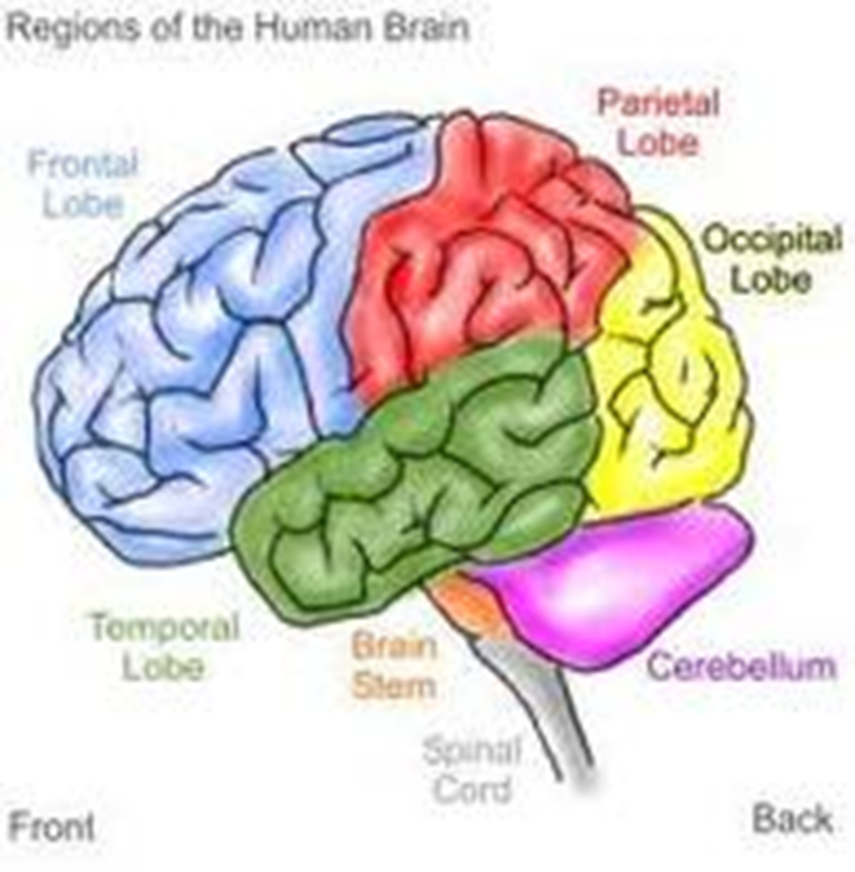
Parietal lobe
Frontal lobe
Occipital Lobe
Temporal lobe
Brain stem
Cerebellum
Spinal cord

