Slide 1
Disorders of the nervous system
HS1 – Section 8

Slide 2
Alzheimer's disease

Slide 3
Alzheimer's disease
Progressive disease – starts w/ little things
No known cause
No cure ☹ **Mind stimulation helps (crossword puzzles, consistency, signs around the house..etc…)

Slide 4
Cerebral palsy (CP)

Slide 5
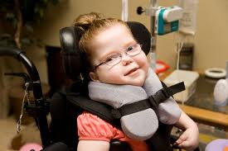
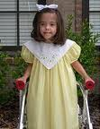
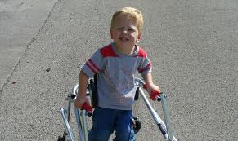
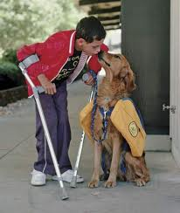
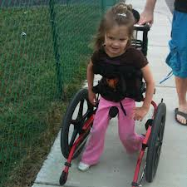

Slide 6
Cerebral palsy
Disturbance w/ voluntary muscular action
? birth injury or abnl. brain development
Sx: head rolling, grimacing, difficult speech and swallowing
No prob. w/ intellect

Slide 7
Epilepsy

Slide 8
epilepsy
Seizure disorder
recurring & hyper d/c from neurons
Cause – uncertain
Usually aura’s prior
2 Types:
Grand mal – severe, convulsive seizure
Petit mal – milder

Slide 9
Hydrocephalus

Slide 10
hydrocephalus
Increased vol. of CSF in brain ventricles
Usually, blockage in 3rd or 4th ventricle
Enlargement of head
Bypass or shunt performed to relieve pressure

Slide 11
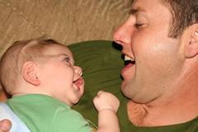
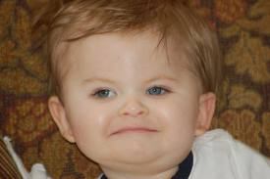
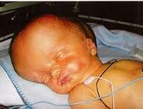
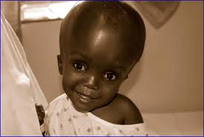

Slide 12
meningitis

Slide 13
meningitis
Inflammation of the lining of the brain & spinal cord
bacterial or viral
Sx – HA, fever and stiff neck
If severe, may lead to paralysis, coma and death
If bacterial, may be treated with abx
Vaccine

Slide 14
Multiple sclerosis

Slide 15
ms
Chronic inflammatory disease of CNS
Immune cells attack myelin sheath of axon
No known cause
Sx – weak limbs, numbness, diplopia, speech problems, loss of coordination, ? paralysis
Typically strikes age 20 – 40 & women

Slide 16
neuritis

Slide 17
neuritis
Inflammation of a nerve
Sx : severe pain, hypersensitivity, loss of sensation, muscular atrophy and weakness,
PARESTHESIA (tingling, burning, and crawling of skin)
Causes – may be infectious, chemical, or because of other conditions
Rx – eliminate cause, analgesics

Slide 18
Parkinson’s disease

Slide 19
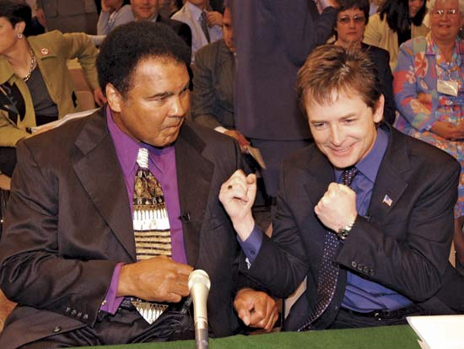
Parkinson’s disease
Sx – tremors, shuffling gait, pill-rolling, and muscular rigidity
Decrease in neurotransmitter “dopamine”
Rx –drugs to treat symptoms

Slide 20
Poliomyelitis (polio)

Slide 21
polio
Disease of nerve pathways of spinal cord – causing paralysis
Almost eliminated in USA (vaccine)

Slide 22
West nile virus

Slide 23
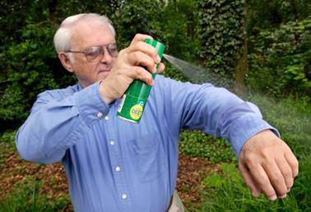
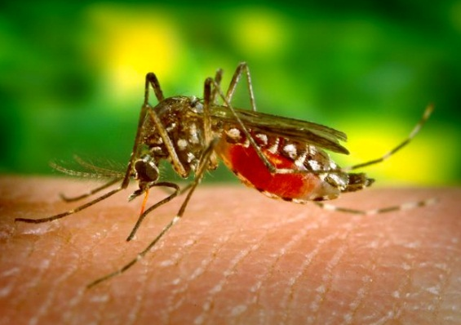
West nile virus
Mosquito-borne virus that can causes meningitis.
Spread to humans by the bite of an infected mosquito
Mosquito becomes infected by an infected bird
Some have flu like sx or no sx at all
Key is prevention

Slide 24
Cerebral Vascular Accident (cva or stroke)

Slide 25
cva
Interruption of blood and O2 to brain
3rd leading cause of death in USA
Risk Factors
􀂃 Smoking
􀂃 Htn
􀂃 Heart disease
􀂃 Family hx
Causes of CVA
90% caused by blood clots
10% caused by ruptured blood vessels in the brain

Slide 26
Cva cont..
Sx
Hemiplegia on opposite side of the body
Sudden, severe ha
Dizziness
Sudden loss of vision in one eye
Aphasia
Dysphasia
Coma
Tx
Get to the hospital immediately!!
CT done to determine etiology
If a clot, treatment aimed at dissolving clot
Prevention
one asa a day
Stop smoking
Exercise and lose weight
Control htn

Slide 27
Spinal cord injury

Slide 28
Spinal cord injury
2 types:
Complete. - almost all feeling/ability are lost below the spinal cord injury
Incomplete. - some function below the injury area.
Tetraplegia or quadriplegia. arms, hands, trunk, legs and pelvic organs are all affected

Slide 29
