Slide 1
HS1 – Section 5
Lymphatic System
&
Immunity

Slide 2
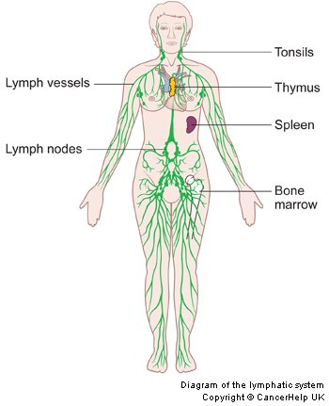
Lymphatic System Components
supplement to the circulatory system.
Contains:
Lymph
Lymph nodes
Lymph vessels in the
intestinal tract
Tonsils
Spleen
Thymus

Slide 3
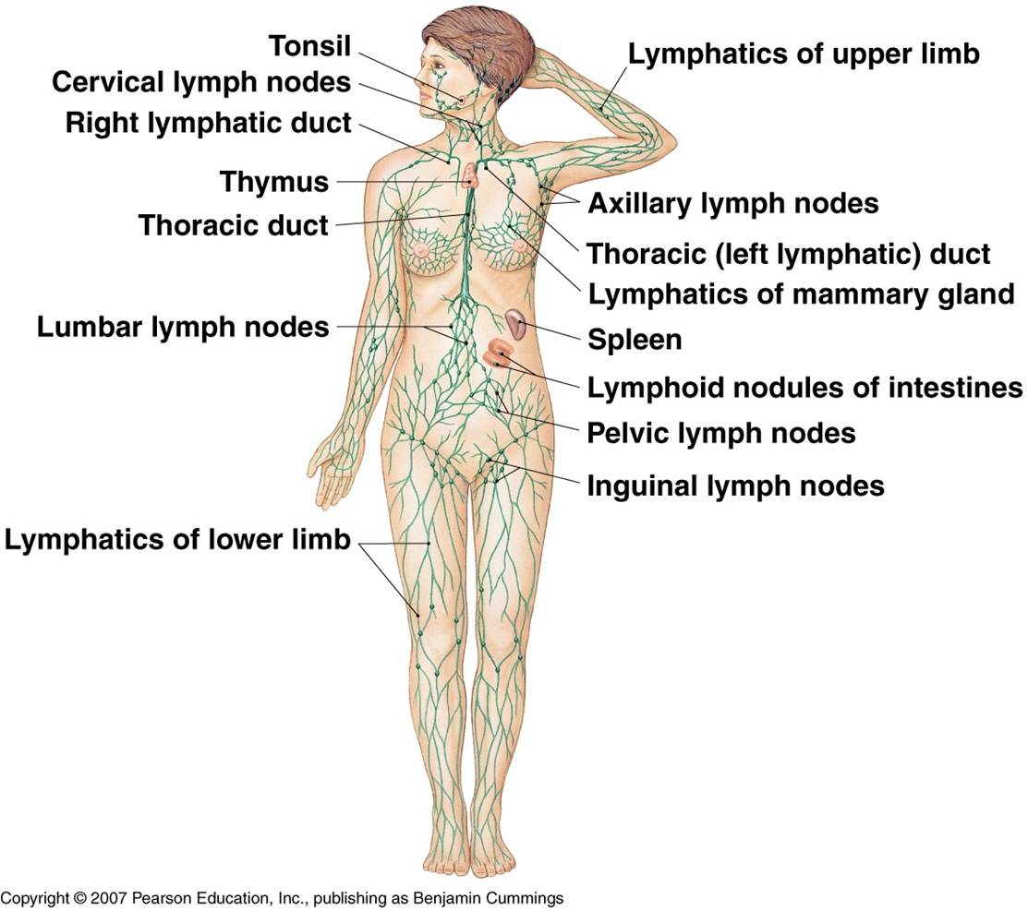

Slide 4
Functions & components

Slide 5
Lymph Fluid
“Interstitial Fluid”
Straw-colored
Diffuses from capillaries into the tissue spaces
Fills the surrounding spaces between tissue

Slide 6
Lymph Fluid Cont…
Intermediary b/t blood in capillaries & tissues
Carries digested food, O2 & hormones to cells.
Carries metabolic waste products away from cells & back into capillaries for excretion.

Slide 7
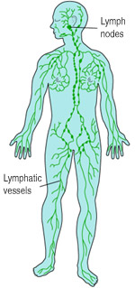
Lymph Vessels
Branchlike system
Parallel to veins
Transports excess tissue fluid back to circ. system.
Travels in only 1 direction: from the body organs to the heart.
2 Large Main Vessels…

Slide 8
2 Main Lymphatic Vessels
Thoracic duct –
“left lymphatic duct”
receives lymph from the L side of the chest, head, neck, abd. area, and lower limbs.
2. Right Lymphatic Duct –
Lymph from the right arm, right side of the head, and upper trunk.

Slide 9
Lymph Nodes
Tiny, oval shaped structures
Range in size from pinhead to an almond
Located along lymph vessels around the body.

Slide 10
Lymph Nodes
Provides a filter for screening out harmful substances (bacteria, cancer cells, etc..)
If substances can’t be destroyed by lymphocytes, the node becomes inflamed (adenitis = swelling of lymph nodes

Slide 11
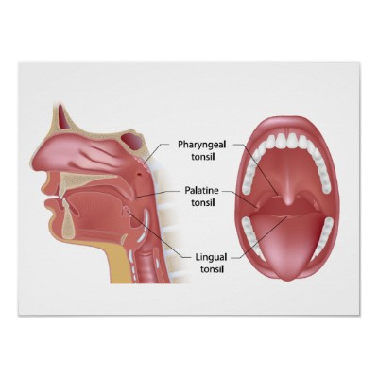
Tonsils
Masses of lymphatic tissues capable of producing lymphocytes and filtering bacteria
3 Pair…..

Slide 12
3 Pairs of Tonsils
Palatine – most common
-located on the sides of the
soft palate.
2. Adenoids – “pharyngeal”
-located on the upper
part of the throat.
3. Lingual – found at the back
of the tongue.

Slide 13
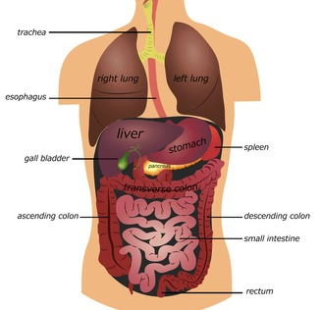
Spleen
Sac like mass of lymphatic tissue.
Location:
b/t the stomach and the diaphragm in the L hypochondriac region

Slide 14
Spleen
5 Functions:
Stores large amt’s of RBC’s
Filters blood
Contracts during exercise or heavy bleeding forcing rbc’s into circulation
Destroys & removes old or fragile rbc’s
Forms RBC’s in the embryo

Slide 15
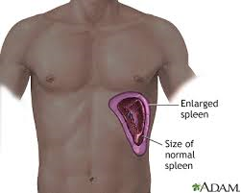
Spleen Cont…
Q: Can you live without a spleen?
A: Yes ☺
-Spleen is not considered a vital organ
-your resistance to infection is lowered initially –Other organs like the liver take over the spleens responsibilities.

Slide 16
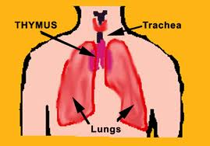
Thymus
Produces Lymphocytes called “T-Lymphocytes”
Consists largely of lymphatic tissue.
Can be considered an endocrine glad because its hormone secreting.

Slide 17
Immunity

Slide 18
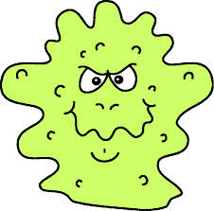
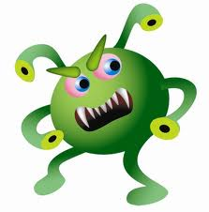
What is Immunity?
The body’s ability to resist invaders and the disease they cause

Slide 19
Types of Immunity
1. Natural Immunity 2 . Acquired Immunity
Passive Acquired Active Acquired
Natural Artificial
Acquired Acquired

Slide 20
Natural Immunity
Born with
Inherited & permanent
Consists of:
Unbroken skin
Mucus
Tears
Blood phagocytes
Local Inflammation

Slide 21
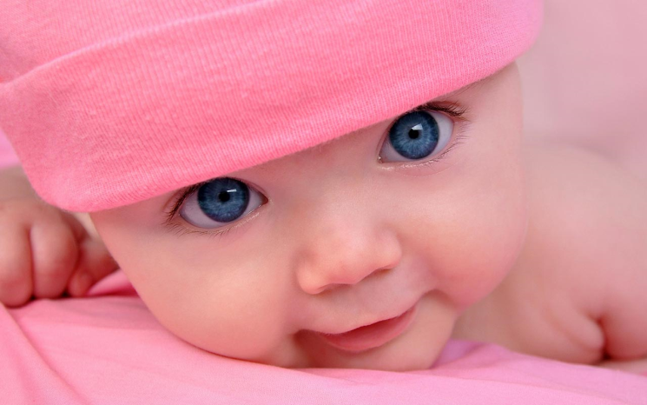
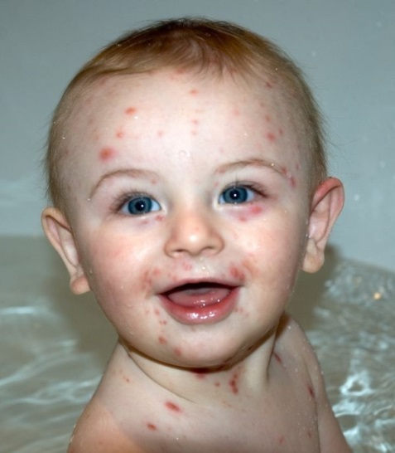
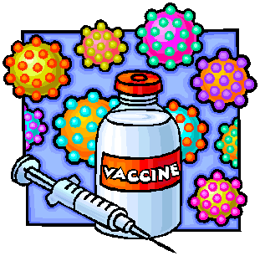
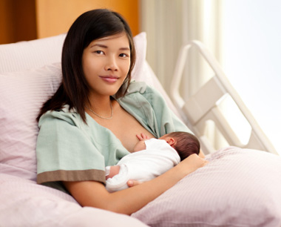
Acquired Immunity
Reaction that occurs as a result of exposure to an invader.
Developed during ones lifetime
2 types: passive or active

Slide 22
2 types of Acquired
Passive Acquired
“Borrowed”
from injecting antibodies
Baby's have temporary from mothers antibodies which pass through the placenta.
Also babies receive through breastmilk.
Only lasts a few weeks (except breastmilk – lasts as long as you do it)

Slide 23
2 types of Acquired
Active Acquired
Lasts longer than passive
2 types: Natural acquired and Artificial Acquired

Slide 24
2 Types of Active Acquired Natural Acquired
Result of having had & recovered from the disease
Chickenpox, measles….
Ex: Child who has had measles and has recovered will not ordinarily get the measles again b/c the child's body has manufactured antibodies.
Example 2: A person has a series of unnoticed or mild infections – becomes immune.

Slide 25
2 Types of Active Acquired Artificial Acquired
Being inoculated with a suitable vaccine, antigen, or toxoid.
Example: A child vaccinated for measles has been given a very mild form of the disease; the child's body will thus be stimulated to manufacture its own antibodies.

Slide 26
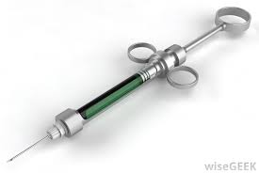
Immunizations
Process of increasing a persons resistance to an infection by artificial means.
Vaccine injected body makes antibodies against that disease.

Slide 27
Immunizations Cont…
Q: Can a vaccine make you sick or give you that virus?
A: If an inactivated vaccine – NO!
if activated or live it can
Give you a very minor form
Of the virus but not enough
To even notice.

Slide 28
Immunoglobulin
A protein that functions as an antibody.
Made from donated human blood plasma.
Contains antibodies that protect the body against diseases
5 classes:
IgG
IgM
IgA
IgD
IgE

