Slide 1
Health Team Relations
Class Overview
&
Policies

Slide 2
Welcome!
Welcome to my class! Health Team Relations is an exciting introductory course into the Health Care Field. I truly have a passion for this field and am excited to introduce students to it! I love and welcome communication with student/parents. If there is anything that comes up or questions you may have please don’t hesitate to contact me by email or at the school. Hoping for a great semester!

Slide 3
Contact information
Email: jill.best@cravenk12.org
Website: jbestnbhs.weebly.com
School Phone: 514-6400
Room #: 354
Planning: 3rd period

Slide 4
Class supplies
For the best organization in this class I recommend:
½” notebook full of lined notebook paper with 9 dividers (composition/spiral notebooks don’t hold worksheets and such)
notecards or “Quizlet” App
Pencil/Pen/Highlighters
Basic calculator (not needed until the last section)
Students are welcome to take notes using their computer/iPad/tablet if they prefer and I welcome smart phones and various devices for different class activities.

Slide 5
Scrub days
Scrub days are every Wednesday
Students are allowed to wear scrubs for extra credit (100 point extra credit assignment every week).
Scrubs must be worn all day and without sandals to receive full credit.
This is not a requirement so please do not feel obligated to purchase a uniform.
If students plan to go on to Health Science 1 & 2 they will be required to wear scrubs to assist with the blood drive & black or red is asked for that day.

Slide 6
Extra credit
Beside scrub days, students will receive an extra credit card to keep with them at all times.
I give lots of opportunity to receive extra credit: review games, turning projects in early, going above and beyond what is expected, and others.
The other way students can earn extra credit is donating classroom supplies. Supplies my classroom uses the most are dry erase markers, tissues, and hand sanitizer. I also have an Amazon “Class wish list” on my website ☺

Slide 7
What will we discuss this semester?
Medical Terminology
History of Medicine
Health Care Systems
Personal Qualities of a Healthcare Worker
Careers in Health Care
Legal & Ethical issues in Healthcare
Cultural Diversity in Healthcare
Medical Math
*Vital Signs (section practiced all year, but tested in the Careers section)

Slide 8
maturity
Maturity is a MUST for this class. Mature topics related to health care and the human body are discussed & students need to handle in a mature way. All topics are strictly curriculum related.

Slide 9
Grade Breakdown
Homework 10%
Quiz 20%
Projects 30%
Tests 40%
Final Exam 25% of final average ( 100 question, state made, multiple choice)

Slide 10
Tests & Reviews
Test dates will be posted on the board when we start a new section.
The day before the test will always be test review day (we will never learn new material the day before a test)
If you are absent on review day, you are still responsible for the test.
Test reviews will be given the day before and are worth 2 homework grades.
If you did your review 100%, you are able to do test corrections for half credit (ex: if you got an 80 on the test you would get a 90).

Slide 11
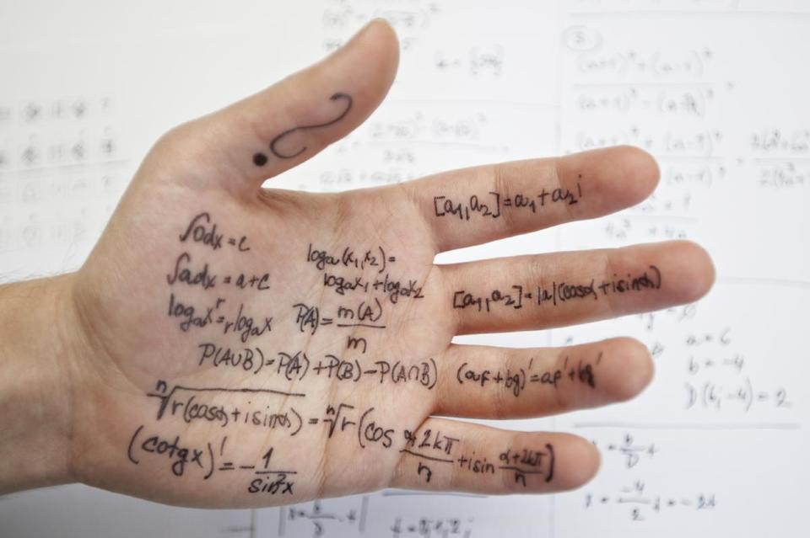
Cheating
If you are suspected and caught of cheating, you will be given a 0 automatically.
If you are caught with someone else's paper/homework/review, you will both be given a 0.

Slide 12
Makeup Work
If you are absent, it is YOUR responsibility to get what you missed.
Test reviews are the only assignment I don’t take late.
Please keep up with your powerschool and makeup anything that needs to be done before report cards.

Slide 13
What is after health team relations?
If you enjoy this class, & think you want to learn more –the next steps in the Health Science pathway are as follows:
Health Science 1 (anatomy & physiology with a focus on disorders of each body system) (Honors with me ☺)
Health Science 2 (Very similar to HTR but more in depth)
Public Health Fundamentals (focus is on becoming a home health assistant)
Nursing Fundamentals (Nursing Assistant Course – 10 medically bound students are chosen after an application/interview process).

Slide 14
Lets have a great semester!!

