Slide 1
DISORDERS OF THE EYE

Slide 2
CATARACT
Lens of eye becomes cloudy
Frequently occurs in people over 70
Painful, gradual blurring of vision
Pupil turns milky white
Rx – surgical removal of the lens

Slide 3
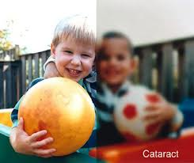
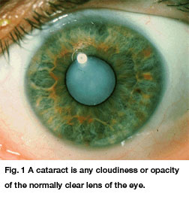
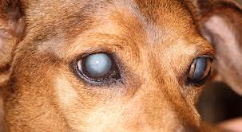

Slide 4
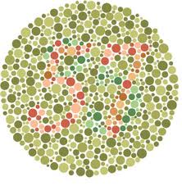
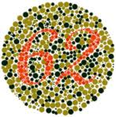
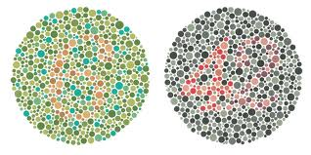
COLOR BLINDNESS
cones affected
genetic disorder that is carried by the female and transmitted to males

Slide 5
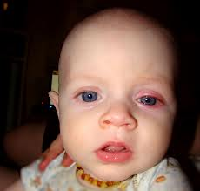
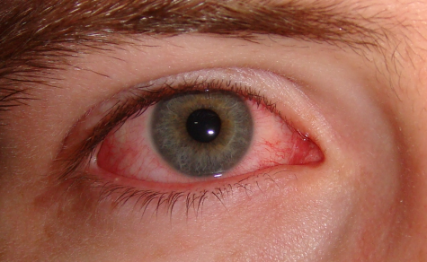
CONJUNCTIVITIS
“Pink eye”
Inflammation of conjunctival membranes
Redness, pain, swelling and discharge
Very contagious
Rx – abx eye gtts

Slide 6
Detached retina
Cause: aging or trauma
Sx: loss of peripheral vision
Tx: laser or freezing

Slide 7
Diabetic retinopathy
Damaged retina as a complication from diabetes
Tx: surgery, control DM
Can lead to blindness

Slide 8
Glaucoma
intraocular pressure causing destruction of the retina & atrophy of the optic nerve
#1 cause ageing
Sx: mild pain, no peripheral vision, halo around the light
TONOMETER – measures intraocular pressure
Rx – drugs or laser surgery

Slide 9
Macular Degeneration
Central part of the retina “macula” which deteriorates.
Sx: Dimming or distorted vision
Tx: Laser, glasses, contacts

Slide 10
Vision Problems Normal = 20/20 Blind = 20/200
Snellen Chart
Ametropia = blurry vision
Presbyopia = above r/t aging
Hyperopia = farsightedness (can only see far away)(Tx w/ convex lenses)
Astigmatism = “Uneven eyes”
irregular curvature of cornea

Slide 11
Vision Problems
Myopia =nearsightedness (Tx w/ concave lenses)
Diplopia = double vision
Strabismus = cross-eyed, usually in children
OD = right eye
OS = left eye
OU = both

