Slide 1
Disorders of the Digestive System
Not just a stomach ache….

Slide 2
What will we cover?
Anorexia
Caries
Cholecystitis
Cirrhosis
Cleft Palate
Constipation
Diarrhea
Gastroenteritis
Gastroesophageal Reflux Disease
Hepatitis
Irritable Bowel Syndrome
Peptic Ulcers

Slide 3
Anorexia Nervosa
Eating Disorder characterized by extreme weight loss

Slide 4
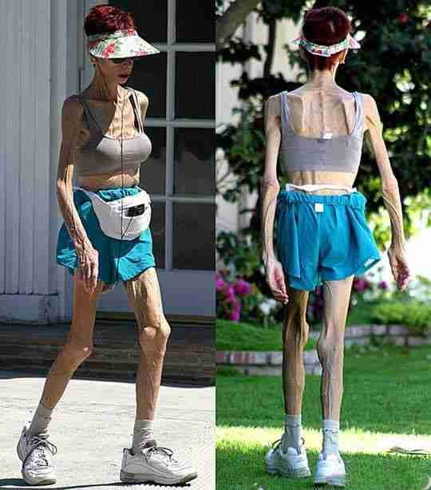
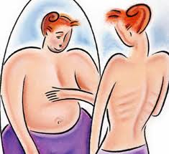

Slide 5
Anorexia Nervosa
Usually by Starvation.
Most common in high achieving, Caucasian, females.
Dx by 15% or more below the normal weight
Complications include….

Slide 6
-Associated mental disorders: depression, anxiety disorders, obsessive-compulsive disorder, substance abuse
Cardiovascular (Heart):
-Slow irregular, pulse
-Low blood pressure
-Dizziness or faintness
-Shortness of breath
-Chest pain
-Decreased potassium levels may result in life-threatening cardiac arrhythmias or arrest
-Electrolyte imbalances may leato life-threatening cardiac arrhythmias or arrest
Muscular Skeletal (Bones):
-Stunted growth in children
-Stress fractures and broken bones more likely
-Osteoporosis
Mouth:
-Enamel erosion
-Loss of teeth
-Gum disease
-“Chipmunk cheeks”- swollen salivary glands from vomiting
-Sore throat because of induced vomiting
Esophagus:
-Painful burning in throat or chest
-May vomit blood from small tear(s) in esophagus
-Rupture of the esophagus, may lead to circulatory collapse and death
Endocrine System:
-Thyroid abnormalities
-Low energy or fatigue
-Cold intolerance
-Low body temperature
-Hair becomes thin and may fall out
-Development of fine body hair as the body’s attempt to keep warm
Stomach:
-Stomach may swell following eating or binging (causes discomfort and bloating)
-Gastric rupture due to severe binge eating (gastric rupture has an 80% fatality rate
Vomiting causes severe electrolyte imbalance which can lead to sudden cardiac arrest.
Intestines:
-Normal movement in intestinal tract often slows down with very restricted eating and severe weight loss
-Frequent Constipation
-Chronic irregular bowel movements
Complications Associated with Laxative Abuse:
-Kidney complications
-“Cathartic colon,” refers to the colon’s inability to function normally without the use of large doses of laxatives due to the destruction of the nerves in the colon that control elimination
-Electrolyte imbalance
-Dehydration
-Potassium depletion
-Dependence on laxatives

Slide 7
Caries
Dental Cavities

Slide 8
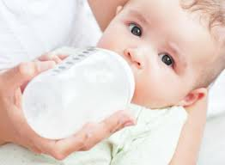
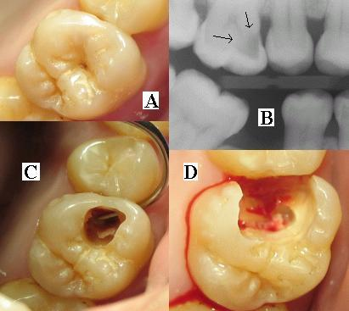
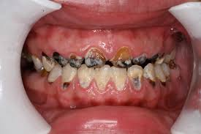
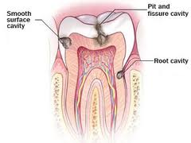

Slide 9
Caries
Bacterial infection
Causes demineralization & destruction of the hard tooth surface
Causes: Poor Oral Hygiene, Dietary Intake, Genetics

Slide 10
Cholecystitis
Inflammation of the gallbladder.

Slide 11
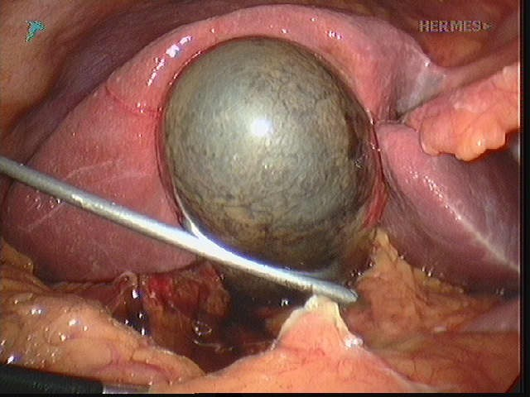
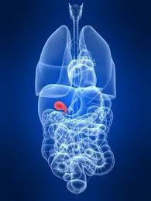

Slide 12
Cholecystitis
Occurs when bile becomes trapped in the gallbladder
90% caused by gallstones (hard, pebble-like deposits)
Sx: URQ pain
Clay-colored stools
Fever
N&V
Jaundice

Slide 13
Cholecystitis Cont…
- Tx: nonsurgical treatment includes:
Antibiotics to fight infection
Low-fat diet (when food can be tolerated)
Pain medicines
Surgical treatment:
Cholecystectomy

Slide 14
Cirrhosis
Chronic, progressive inflammatory disease of the liver.

Slide 15
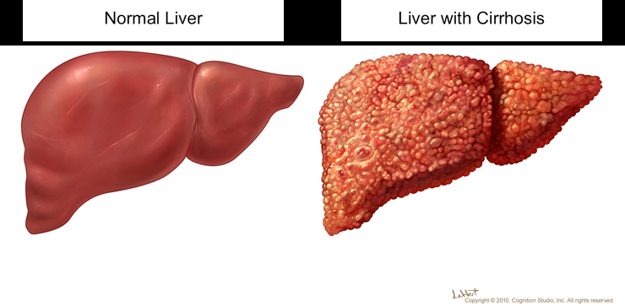
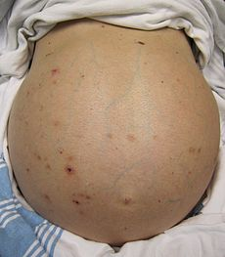
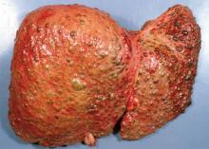

Slide 16
Cirrhosis
-final phase of chronic liver disease.
-75% caused by excessive alcohol use or Hep B & C
-Early Sx:
Fatigue, Poor appetite, nausea
-Late Sx:
edema, Jaundice, easy bruising, swollen abd.
-Tx:
Limiting alcohol
Healthy/Low Salt diet
Vaccines
Meds
Liver Transplant

Slide 17
Cleft Palate
Birth defect affecting the roof of your mouth

Slide 18
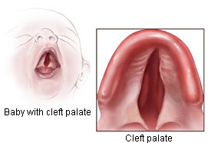
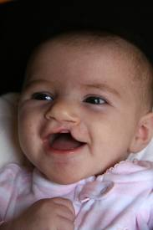
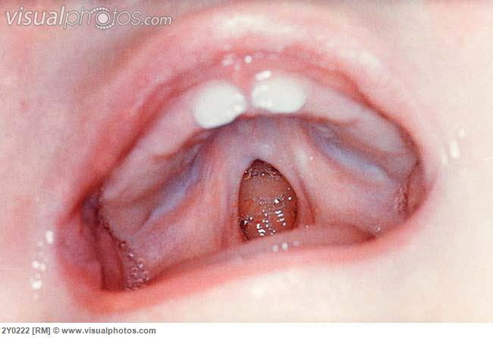
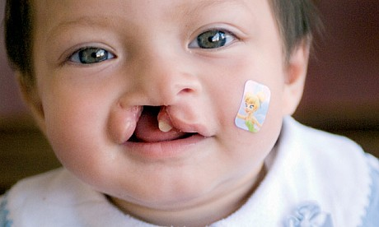

Slide 19
Cleft Palate
Causes:
Genetics
Drugs
viruses
other toxins
-Can accompany cleft lip
Tx: - Surgery w/in 1st year to prevent speech delays.
-temporary prosthetic device to close the palate so the baby can feed and grow until surgery can be done.

Slide 20
Constipation
Delayed & painful defecataion

Slide 21
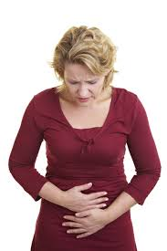
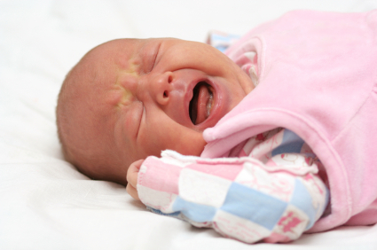
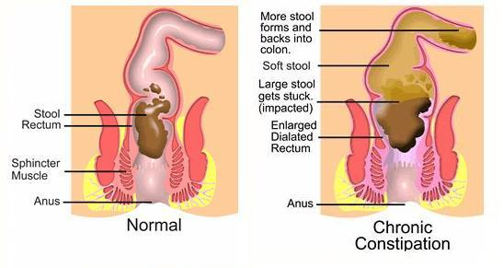

Slide 22
Constipation
Common Causes:
Diet (lack of fruits/vegis, fluids)
Meds
Various Dx/Pregnancy
Stress
Tx:
Diet modifications
exercise
Laxatives
Decrease stress
Complications: Bloody stools, rectal prolapse

Slide 23
Diarrhea
Loose watery, & frequent bowel movement

Slide 24
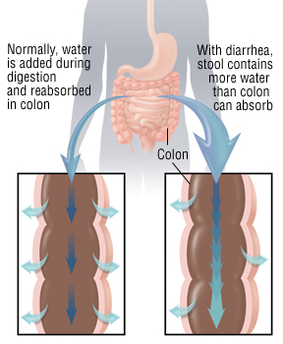
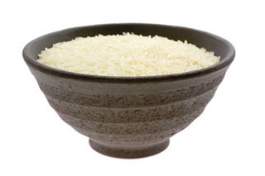
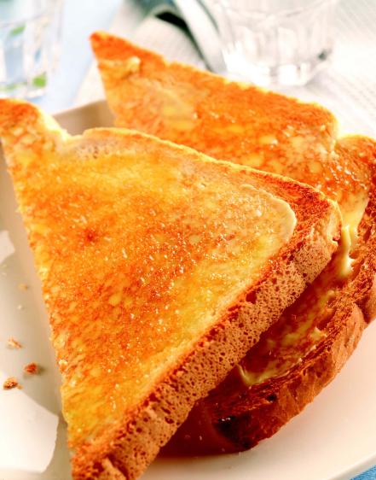
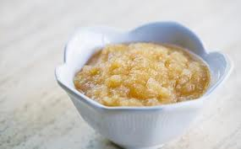
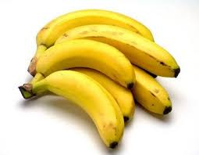

Slide 25
Diarrhea
Common Cause:
poor diet
anxiety
toxic substances
irritants in food
Complications
dehydration and electrolyte imbalance
Tx:
BRAT diet
Rest
Fluids

Slide 26
Gastroenteritis
Inflammation of the mucus membrane lining of the stomach and intestinal tract

Slide 27
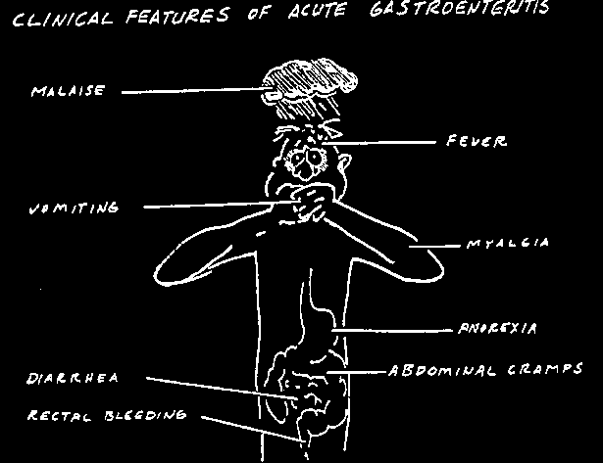

Slide 28
Gastroenteritis
Common Cause:
Virus which causes n/v/d for 24-36 hours
Tx:
NPO x 2 hours after vomiting stops
then clear liquids (No red) x 24 hours
then advance to BRAT diet x 24-48hours
then slowly advance to normal diet
Common Complication: dehydration

Slide 29
GERD
Gastroesophageal Reflux Disease

Slide 30
GERD
“Acid reflux” “Heartburn”
Sx – burning sensation in chest
Tx:
-wait to lay down 2-3 hours after eating (stomach changes position when laying down which can force stomach acid up your esophagus if full)
-Avoid certain foods
-stop smoking
-give birth
-antacids
-Eat slowly

Slide 31
IBS
Irritable Bowel Syndrome

Slide 32
IBS “Colitis”
Large intestine inflamed
Cause – unknown
Sx: episodes of
constipation or diarrhea
Mostly Women
Tx: Prevention & TxSx

Slide 33
Peptic Ulcers

Slide 34
Peptic Ulcers
Sore /lesion that forms in the mucosal lining of the stomach
Cause – H. pylori (bacteria), smoking, alcohol, stress, certain drugs
Sx: burning pain in abd, b/t meals and early AM, may be relieved by eating or taking antacid
Rx – H2 blockers (drugs) that block release of histamine

Slide 35
Hepatitis
Inflammation of the Liver

Slide 36
Hepatitis
HEPATITIS A
Infectious hepatitis
Cause – virus
Spread through contaminated food or H2O
HEPATITIS B (Serum Hepatitis)
Caused by virus found in blood
Transmitted by blood transfusion or being stuck with contaminated needles (drug addicts)
Health care workers at risk and should be vaccinated
Use standard precautions for prevention

