Slide 1
Diagnostic Services Careers
What kind of careers would these be… ?

Slide 2
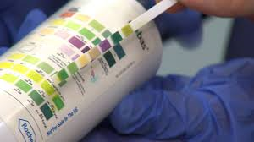
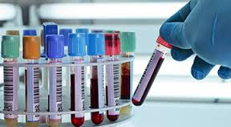
Medical Laboratory Technologist
“MT’s”
Work under a “pathologist”
Study fluids, tissues, & cells for ? Disease
Work in a small lab or large lab…

Slide 3
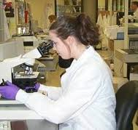
Medical Laboratory Technologist
Small labs – do all tests.
Large labs – will specialize…
-Biochemistry (body fluids)
-Blood bank technology (collection & prep of blood)
-Cytotechnology (study of cells) - -Hematology (blood)
-Histology (body tissue)
-Microbiology (bacteria & microorganisms)
*Bachelors or Masters Degree
NC AVG - $37,000/year

Slide 4
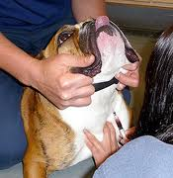
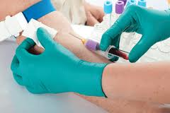
Phlebotomist
“venipuncture technicians”
Collect blood samples & prepare the sample for various testing
Tests on the blood
Work under a medical lab technologist or pathologist (depending on state).
**3 month certificate AVG NC $23,000/YR

Slide 5
Radiologic Technologist
“RT’s “ Work under a radiologist
Use diagnostic tools to dx disease
Associates/Bachelors degree
Can specialize….

Slide 6
Radiologic Technologist Cont...
Specialties:
Radiographers (xrays)
Radiation Therapists (admin. radiation)
Nuclear Medicine Technologists (radioactive substances to administer into a patient.)
Ultrasound technologist “sonographer” (high frequency sound waves into the body. )

Slide 7
Radiologic Technolgist Cont...
Specialties:
Mammographers(Images of the breast)
Computer tomography technologist (CT/CAT scans, obtain cross sections of body tissues, bones, and organs. )
Magnetic Resonance Technologist (MRI, produce detailed images of organs.
Pemission tomography (PET, inject radioactive dyes to detect disease, usually cancer)

Slide 8
Radiologic Technolgist Cont… Salaries
Radiographers $40,000/year
Radiation Therapists $55,000/year
Nuclear Medicine Technologists $55,000/year
Ultrasound technologist $45,000/year
Mammographers $40,000/year
Computer tomography technologist $55,000/year
Magnetic Resonance Technologist $40,000/year
Pemission tomography $45,000/year

Slide 9
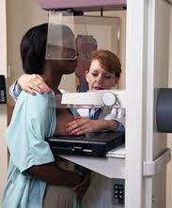
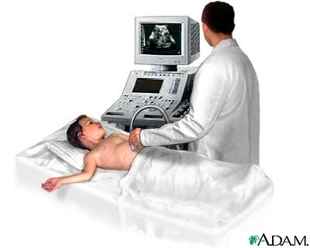
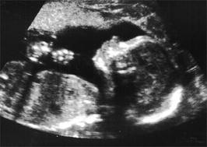
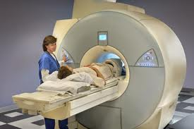
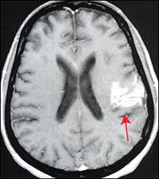

Slide 10
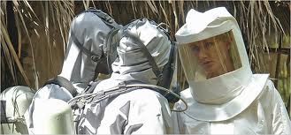
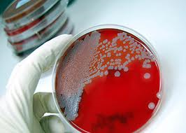
Epidemiologist
Track & identify diseases as they occur in a group of people
Determine risk factors for diseases
Determine methods to prevent new diseases
**Masters or doctorate
$65,000 -$110,000

Slide 11
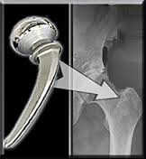
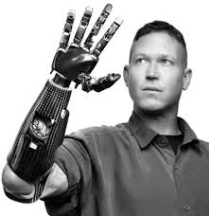
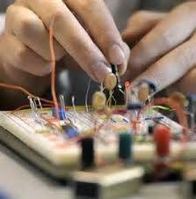
Biomedical Engineer
Researching & designing medical equipment.
Work with biomedical engineering tech’s to manufacture the equipment.
Ex: xray machines, ultrasound machines, scales, limbs etc…
Bachelors degree
Starting @ $57,000

