Slide 1
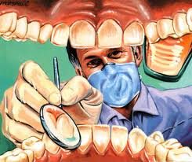
Dental careers
How many teeth do you have?!?!?
32 Adult & 20 Baby

Slide 2
What are dental careers?

Slide 3
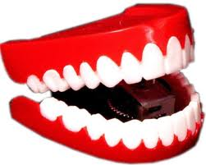
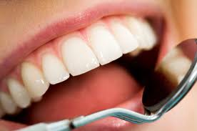
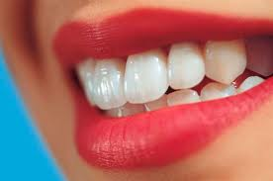
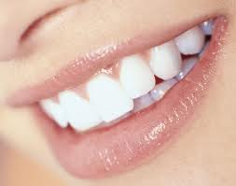
Dental workers focus on the health of the teeth and the soft tissues of the mouth.

Slide 4
Where do they work?

Slide 5
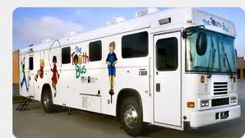
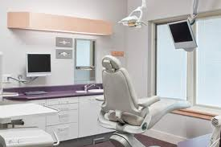
Private dental offices
Dental laboratories
Dental clinics
Dental dept.'s in hospitals, health departments, or government agencies

Slide 6
Its not just about a dentist…

Slide 7
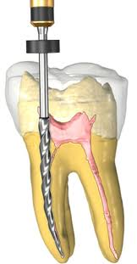
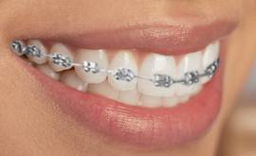
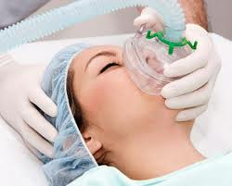
Specialty Areas
Endodontics
Tx of dx’s of the pulp, nerves, blood vessels, and roots of the teeth. Root Canal therapy (RCT).
Orthodontics
Straightening of the teeth
Cosmetic and medical reasons
Oral Surgery
Surgery on the mouth, jaw, and teeth

Slide 8
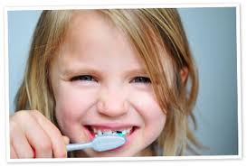
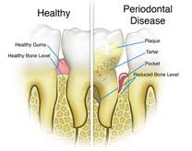
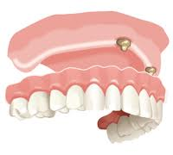
Specialty Areas cont…
Pedodontics
Dental txfor children and adolescents
Periodontics
Prevention & tx of dx of the bone, gums, and structures supporting the teeth.
Prosthodontics
Replacements of natural teeth with artificial teeth (dentures)

Slide 9
Career Details

Slide 10
Dentist
DMD or DDS
Examine teeth and mouth tx disease
Surgery on gums, teeth, and tissues
Educate on prevention
Supervise
Entrepreneurs
Bachelors+ 3-4 yrs of dental school + 2 or more years specialized training
Licensed in state of practice
$84,000 to 200,000

Slide 11
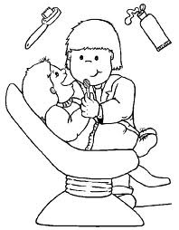
Dental Hygienist
DH or LDH
Works under a dentist
Preliminary exams of the teeth and mouth
Remove stains/deposits and cleans teeth
X-rays
Associates degree and beyond
Most programs are very competitive
$35,700 to $69,000

Slide 12
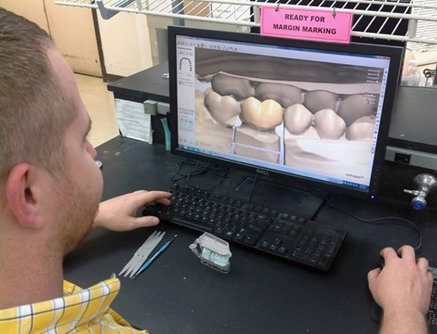
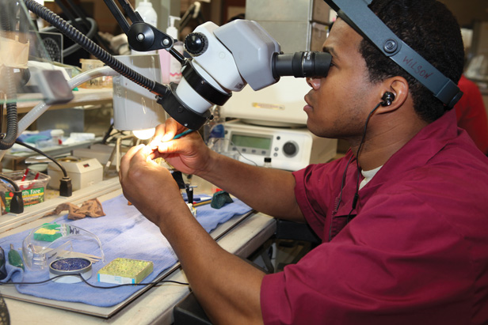
Dental Lab Technicians
DLT’s
Repair and make a variety of dental artificial devices (dentures, crowns, bridges, orthodontic devices)
Work under orders from a dentist
$19,400 – $52,600

Slide 13
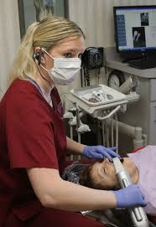
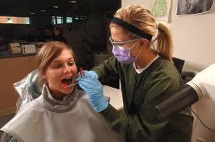
Dental Assistants
DA
Work under a dentist
Pass instruments
Prepare pt for the dentist
Xrays
Teach preventive care
Assist dentist with dental surgery
$22,000-$35,000

Slide 14
Is a dental career for you?

