Slide 1
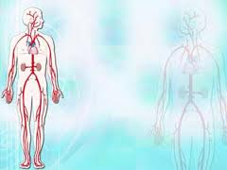
Circulation + Blood Pressure

Slide 2
2 Major Types of Circulation:
Cardiopulmonary – blood from the heart lungs heart
2. Systemic – blood from the
Heart tissues & cells heart.
3 specialized types of Systemic….

Slide 3
3 Specialized systemic routes….
Coronary circulation – blood from the heart myocardium
Portal Circulation – blood from the digestive organs liver via the portal vein
Fetal Circulation – How the fetus obtains O2 and nutrients via the moms blood.

Slide 4
Blood Vessels

Slide 5
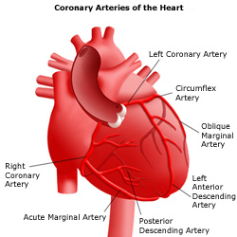
Blood Vessels
3 types: Arteries, Capillaries, & Veins
Arteries
Carries O2 blood away from the heart to the capillaries. (1 exception: pulmonary artery carries deoxygenated)

Slide 6
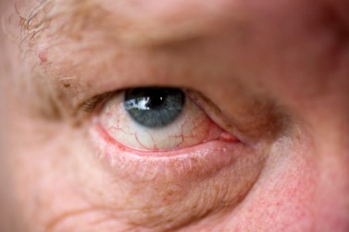
3 type of Blood Vessels Capillaries
Smallest blood vessel
connect arterioles with venules
Made of endothelial cells.

Slide 7
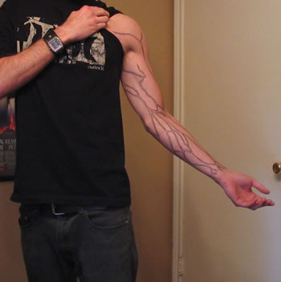
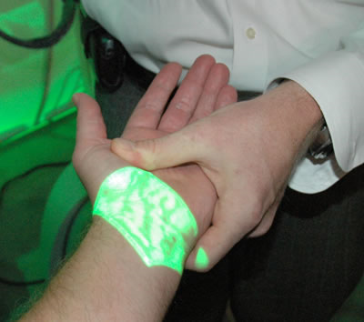
3 types of Blood Vessels Veins
Carry deoxyg. blood away from capillaries to the heart.
3 layers: tunica externa, tunica media, and tunica intima

Slide 8
Principal Arteries
Artery | Area Served | Artery | Area Served
Common Carotid | Head & Face | Slenic | Spleen
Internal Carotid | Brain | Hepatic | Liver
External Carotid | Face | Superior Mesenteric | Small intestines and colon
Vertebral | Spinal Column & Brain | Renal | Kidney
Brachiocephalic | Right arm, head, & shoulder | Common Iliac | Lower abd. Area
Subclavian | Shoulder | Internal Iliac | Pelvis and bladder
Axillary | Axilla area | External Iliac | Groin & Lower Leg
Brachial | Upper arm and elbow | Femoral | Groin
Radial | Arm, wrist | Popliteal | Knee area
Thoracic Aorta | Chest cavity | Anterior Tibialis | Anterior Lower Leg
Celiac | Liver, spleen, stomach and pancreas | Posterior Tibialis | Posterior Lower Leg
 |  | Dorsalis Pedis | Ankle

Slide 9
Principal Veins
Vein | Area Served | Vein | Area Served
External Jugular | Face | Internal Jugular | Head & Neck
Subclavian | Shoulder & Upper Limbs | Brachiocephalic | Right side of head & shoulder
Left Cephalic | Shoulder & axillary | Axillary | Axilla area
Brachial | Upper arm | Radial | Lower arm & wrist
Superior Vena Cava | Upper part of body | Inferior Vena Cava | Lower part of body & abd. Area
Hepatic | Liver | Renal | Kidney
Hepatic Portal | Organs of digestion | Splenic | Spleen
Superior Mesenteric | Small Intestine & Colon | Common Iliac | Lower abd. And pelvis
Internal Iliac | Bladder & Reproductive organs | External Iliac | Lower Limbs
 |  | Dorsal Venous Arch | Foot
Great Saphenous | Upper Leg | Femoral | Upper leg & groin
Popliteal | Knee | Posterior Tibialis | Posterior Leg

Slide 10
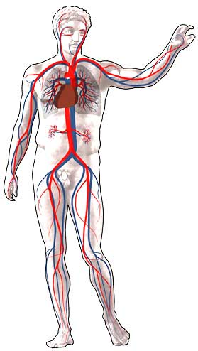
Carotid
Brachial
Brachialcephalic
Radial
Subclavian
Thoracic Aorta
Axillary
ARTERIES
Femoral
Popliteal
Dorsalis Pedis

Slide 11
Subclavian
Jugular
Brachiocephalic
Brachial
Axillary
VEINS
Radial
Superior Vena Cava
Great Saphenous
Inferior Vena Cava
Femoral
Popliteal
Dorsalis Venous Arch

Slide 12
EKG, Blood Pressure & Pulse

Slide 13
EKG Tests for electrical problems with your heart

Slide 14
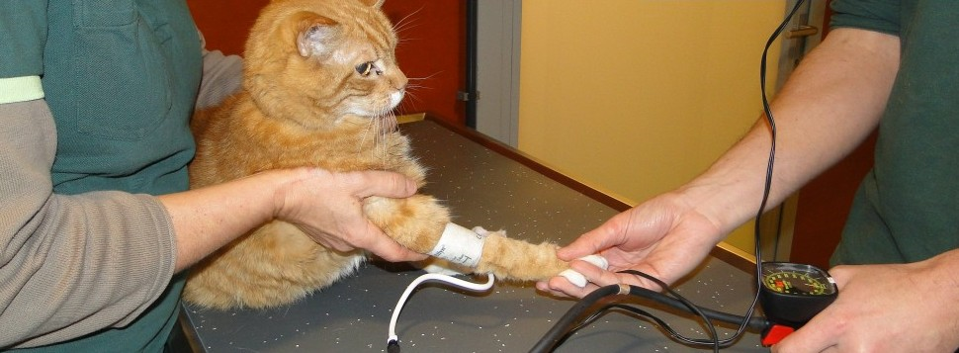
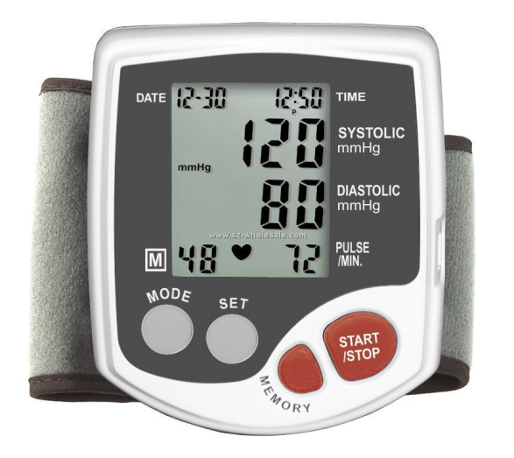
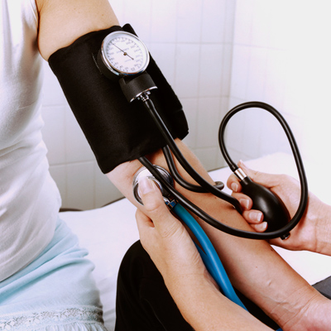
Blood Pressure
the force of blood against the walls of arteries.

