Slide 1
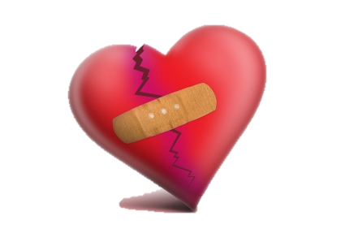
Blood & Circulatory Disorders

Slide 2
Part 1: Blood Disorders

Slide 3
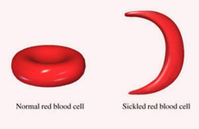
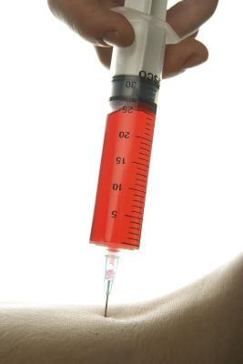
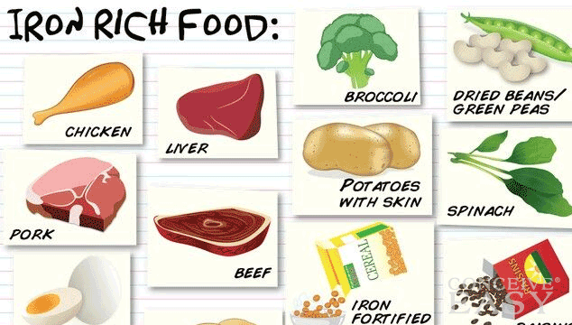
1. Anemia
Definition: Decrease in #/% of rbc’s & hgb
4 Main Types:
Iron Deficiency
Most women, children, adol
Decreased Fe diet
Tx: Fe sup. & More Fe diet
Pernicious
Decr. B12 (metabolism & forms RBC’s),
Sx: dyspnea, pallor, fatigue
Tx B12 injections
Aplastic
Cause: suppressed bone marrow by drugs/radiation
Tx: remove substances, d/c radiation, bone marrow transplant
Sickle Cell
Chronic, inherited
RBC’s crescent shape which carry less O2/break easy
“Crisis” severe joint pain tx’d w/ transfusions
Mostly African American

Slide 4
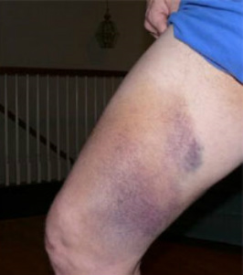
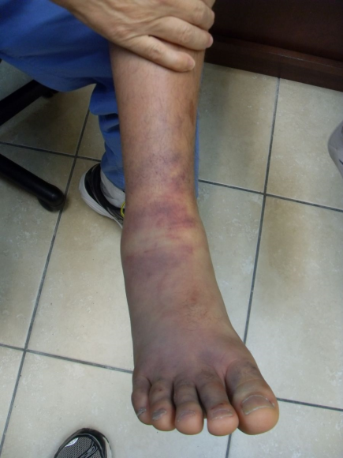
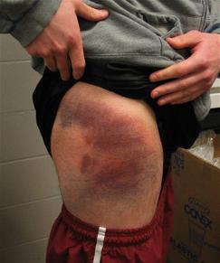
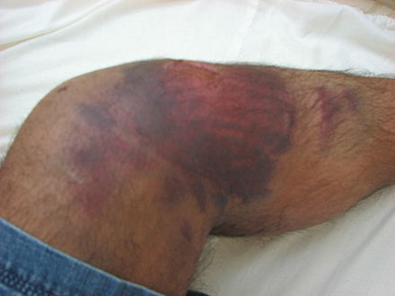
2. Contusion
What is it? Purple/flat “bruise” – damaged or brokn blood vessels
Cause: Blow to skin
Blood leaking from injured blood vessels into tissues
Tx: None
Color changes and eventually goes away
Red –> Blue/purple –> green –> yellow -> brown

Slide 5
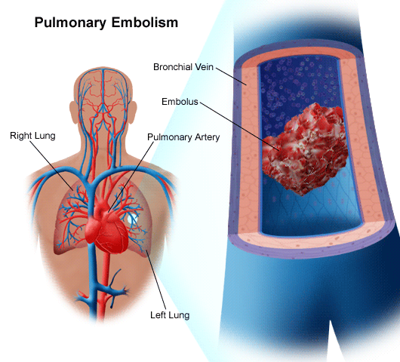
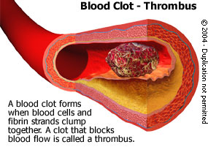
3. Embolism
What is it? Foreign Substance in bloodstream (air,blood,cancer,needle, etc…)
Cause: Substance reaches an artery too small to pass
Tx: anticoagulants, thrombolytics, surgery
Types: Brian, Retinal, Air, Pulmonary, Fat

Slide 6
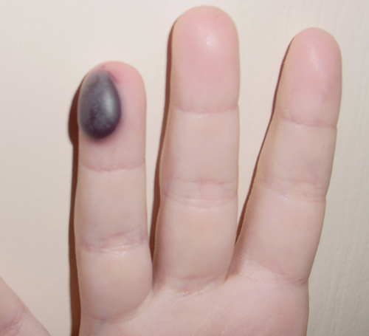
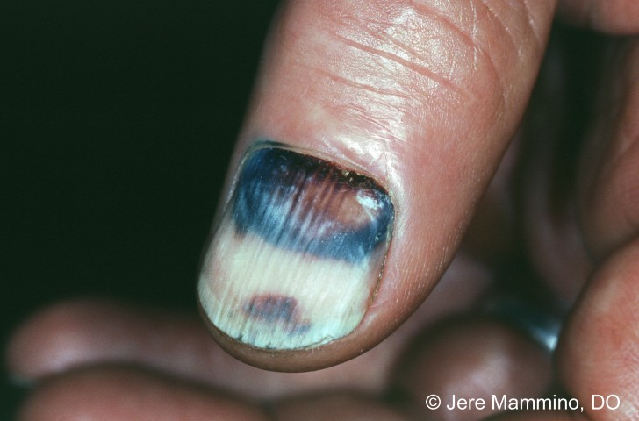
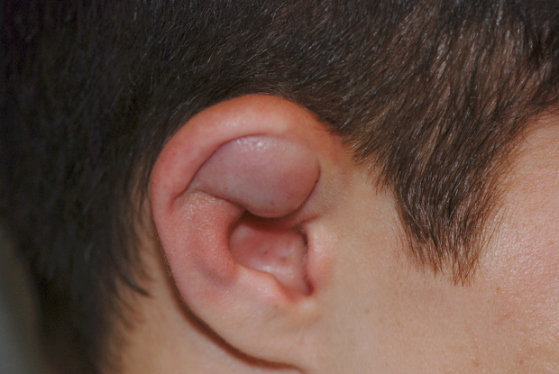
4. Hematoma
What is it? Localized blood clotted mass of blood in an organ, tissue, or space
Cause: Traumatic Injury
Treatment: RICE, Heat, Pain meds, anticoagulant meds

Slide 7
5. Hemophilia
What is it? Slow/abnormal blood clotting disorder resulting in prolonged bleeding
Cause: Hereditary
Tx: Educate to avoid
trauma, missing
clotting factor

Slide 8
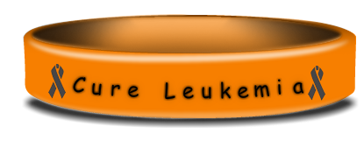
6. Leukemia
What is it? Malignant cond causing increased WBC’s. WBC’s replaced w/ RBC’s
Cause: Increased Risk: Downs syndrome, HIV, genetic predisposition, ? Hair dyes
Tx: Chemo, Radiation, Bone marrow transplant

Slide 9
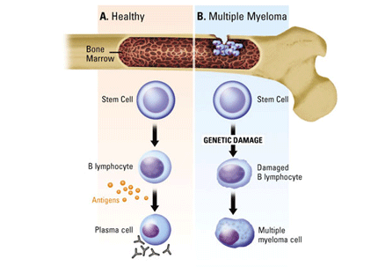
7. Multiple Myeloma
What is it? CA that starts in plasma cells of bone marrow
Cause: Increased plasma cell growth and forms tumors. Increased risk older adults &after radiation
Tx: Chemo, Radiation, Bone marrow transplant

Slide 10
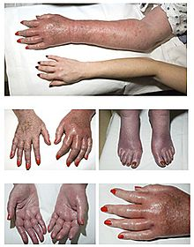
8. Polycythemia
What is it? Too many RBC’s
Cause: sometimes temporary r/t increased altitudes b/c decreased O2, if chronic unknown cause
Tx: Phlebotomy – usually 1 pint.
Or drug therapy

Slide 11
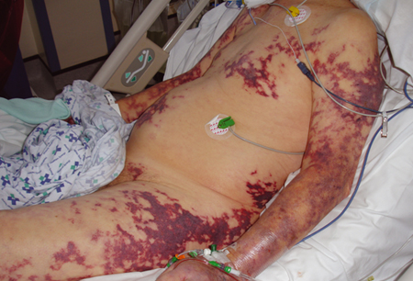
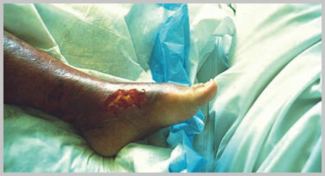
9. Septicemia
What is it? Presence of pathogenic toxins – very serious infection
Cause: During a normal infection
Tx: Hospital Admit – ICU, fluids, Abx, Ox, blood

Slide 12
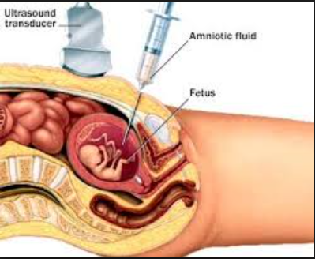
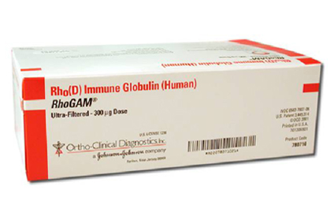
10. Erythroblastosis Fetalis
What is it? “Hemolytic Disease of Newborn” HDN
Blood disorder in the fetus causing clumping of baby RBC’s.
Cause: Rh- mom with RH+ fetus
Tx: Prevention = Rhogam before birth or within 72 hours
Tx = transfusion, meds, light therapy if jaundice

Slide 13
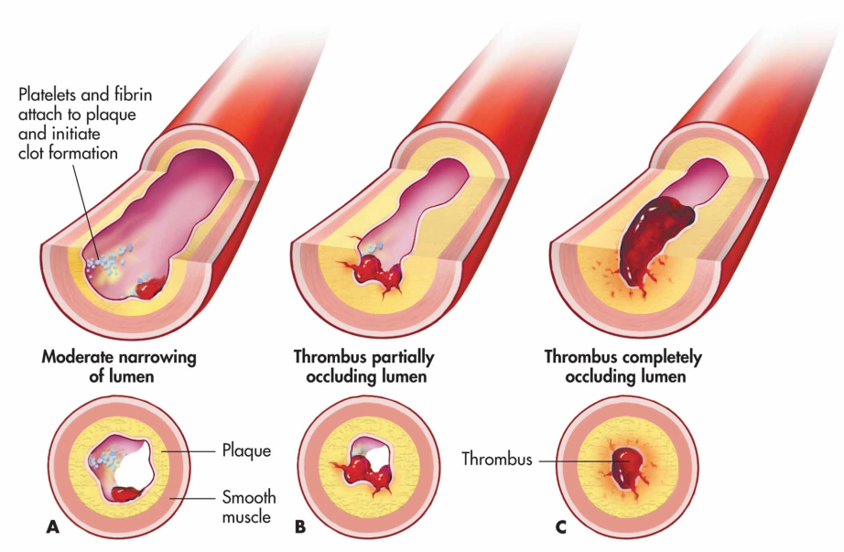
11. Thrombus
What is it? “Blood Clot”
Clot in a blood vessel
Cause: Usually slow blood circulation, changes in blood vessell walls, immobility
Tx: Blood thinners or surgery

Slide 14
Part 2: Circulatory disorders

Slide 15
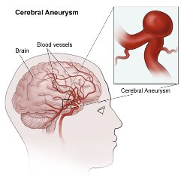
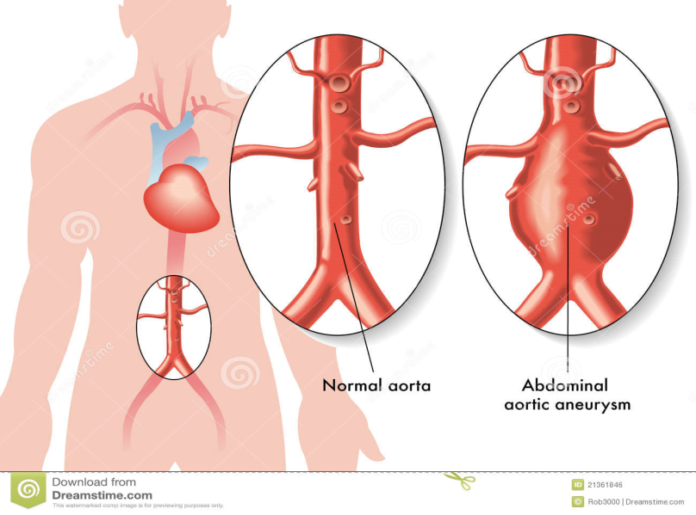
1. Aneurysm
What is it? Abnl widening/balooning of a portion of an artery
Cause: Congenital, HTN, smoking, high cholesterol, heart disease
Tx: Depends on size/location – surgery or stent.

Slide 16
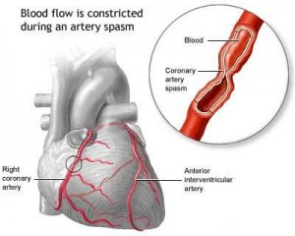
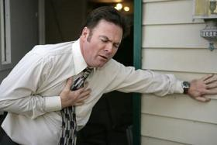
2. Angina Pectoris
What is it? Chest Pain
Cause: Decreased blood flow to heart secondary to HTN, exercise, strong emotions
Tx: Rest, nitroglycerin

Slide 17
3. Arrhythmias
What is it? Any abnormal rhythm
Cause: Lots! Heart dx, thyroid dx, caffeine, meds, diet, lifestyle
Tx: Depends on cause – CPR, meds to prevent, lifestyle changes

Slide 18
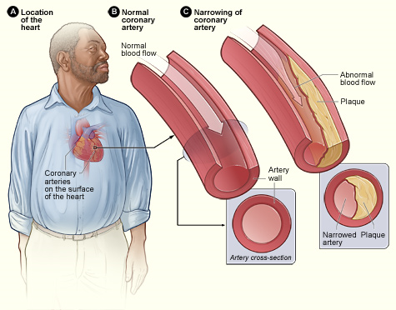
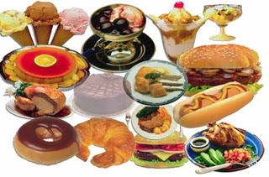
4. Coronary Artery Disease
What is it? Narrowing of the small blood vessels
Cause: Buildup of plaque in the arteries seondary to genetic, increased cholesterol, diet, heart disease
Tx: Meds, lifestyle changes (depends on severity)

Slide 19
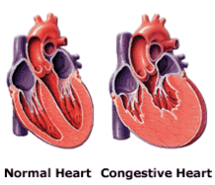
5. Heart Failure “CHF”
What is it? Cond. Where hearts don’t pump enough blood to meet needs.
Cause: CAD (prev. slide), HTN, DM, lifestyle
Tx: Lifestyle changes, meds, surgery, constant checkups

Slide 20
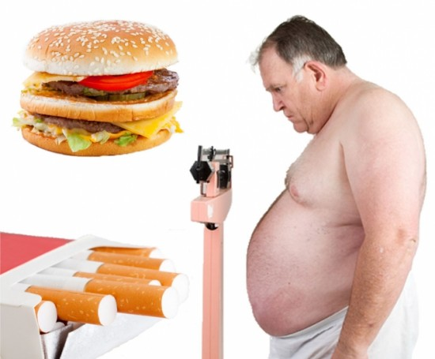
6. Hypertension “HTN”
What is it? High Blood Pressure
Cause: Diet, smoking, obesity, DM, genetics
Tx: Lifestyle changes, meds, surgery, constant checkups

Slide 21
7. Murmurs
What is it? Extra sound in heartbeat
2 types: innocent/flow and abnormal
Cause: Flow – none, usually children
Abnormal – heart disease, rheumatic fever, infections, anemia
Tx: Flow – none
Abnormal – depends on cause, cardiology will follow

Slide 22
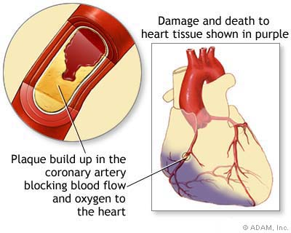
8. Myocardial Infarction
What is it? “Heart Attack/MI”
Blood flow to a part of the heart is blocked and muscle is damaged
Cause: Blood clot, heart disease, HTN, genetics
Tx: Depends on severity – meds, surgery, etc…

Slide 23
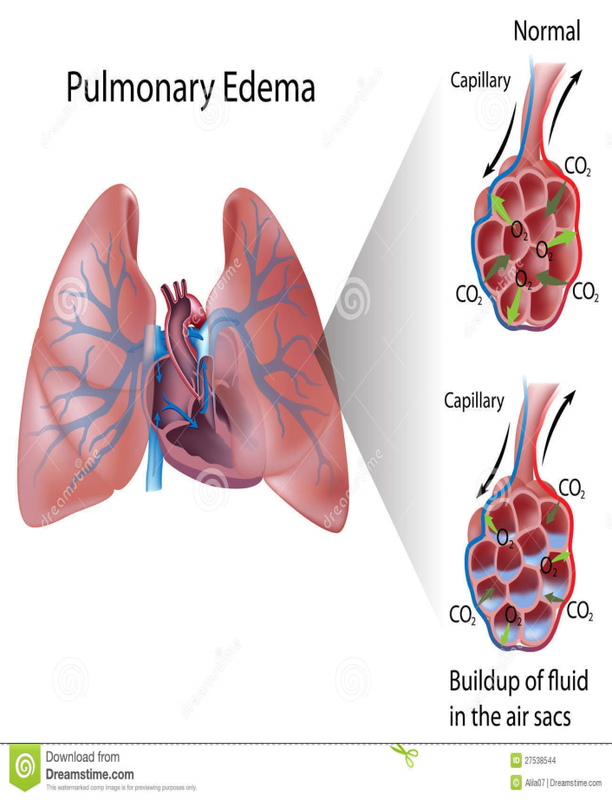
9. Pulmonary Edema
What is it? Abnl buildup of fluid in the air sacs of the lungs
Cause: CHF, altitude, kidney failure
Tx: O2, hospital admit, diuretics

Slide 24
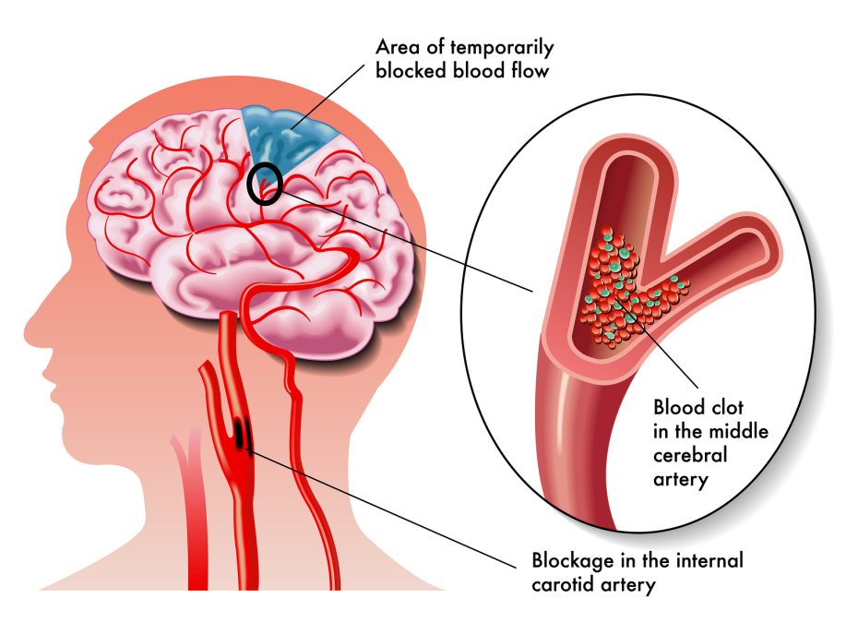
10. Transient Ischemic Attack
What is it? “TIA”. Blood flow to brain stops for a brief period and creates stroke sx x24h.
Cause: clot, blood vessel injury, HTN
Tx: Prevention, surgery, blood thinners, ASA

Slide 25
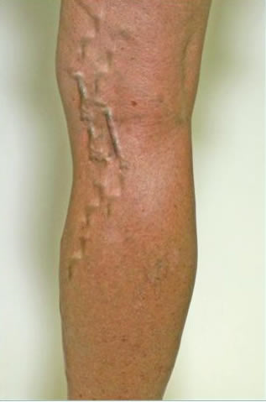
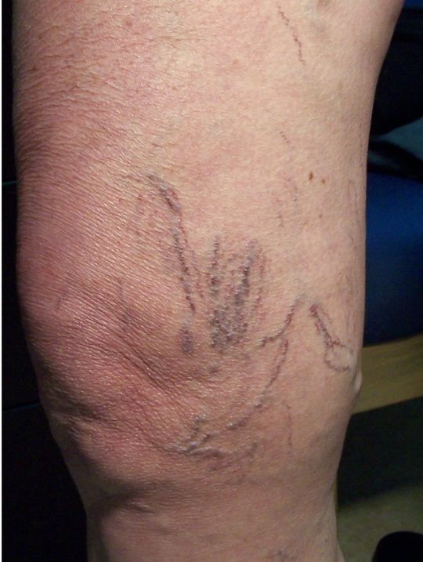
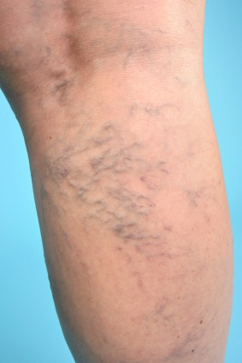
11. Varicose Veins
What is it? Swollen, twisted and sometimes painful veins that fill w/ abnl collection of blood.
Cause: pregnancy, congenital, prolonged standing
Tx: avoid cause, lasers, pain meds prn

Slide 26
12. Peripheral Vascular Disease
Type 1: Arteriosclerosis
What is it: Thickening of arterial walls bc of loss of elasticity r/t age
Cause: DM, fam hx, htn, smoking, age
Tx. Liefstyle changes, bp meds

Slide 27
12. Peripheral Vascular Disease
Type 2: Artherosclerosis
What is it: type of arteriosclerosis
Deposits of fatty substances form along arterial walls
Cause: DM, fam hx, htn, smoking, age
Tx. Liefstyle changes, bp meds

